Slide 1
Implement AI in health care: a regulation perspective in Taiwan
Speaker Dr. WEI-LING CEHN
Affiliation Food and Drug Administration, Ministry of Welfare
Notes:
It is a wonder to be here and honored to share some information about Artificial intelligence and machine learning.

Slide 2
Form 1 – B
The Gastroenterological Society of Taiwan
COI Disclosure
In connection with this presentation, there is no COI to be disclosed with any companies.

Slide 3
Artificial Intelligence in Colonoscopy
Implement AI/ML in health care
Part I: How to teach computers to understand pictures?
Part II: AI/ML classifications
Part III: Guidance for Industry to Register AI/ML-Based SaMD
• IMDRF- International Medical Device Regulators Forum
• FDA-approved AI/ML-Based SaMD
• TFDA review and regulate guidance
Notes:
In this talk, at first, I will introduce Perf. Fei-Fei Li in Department of Computer Science at Stanford University. Her research about "How to teach computers to understand pictures?"
In the second part, I will introduce Artificial intelligence and machine learning classifications. In the last part, I will represent Guidance for Industry to Register AI/ML-Based SaMD from IMDRF, US FDA, and TFDA.

Slide 4
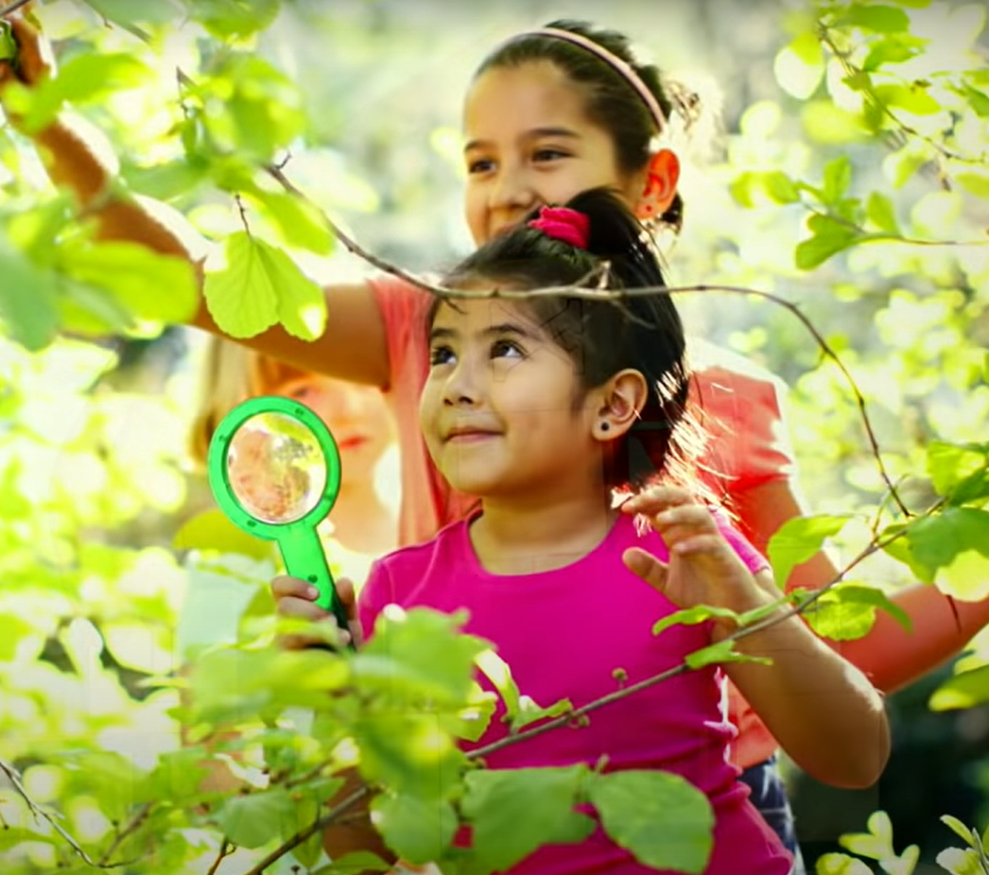
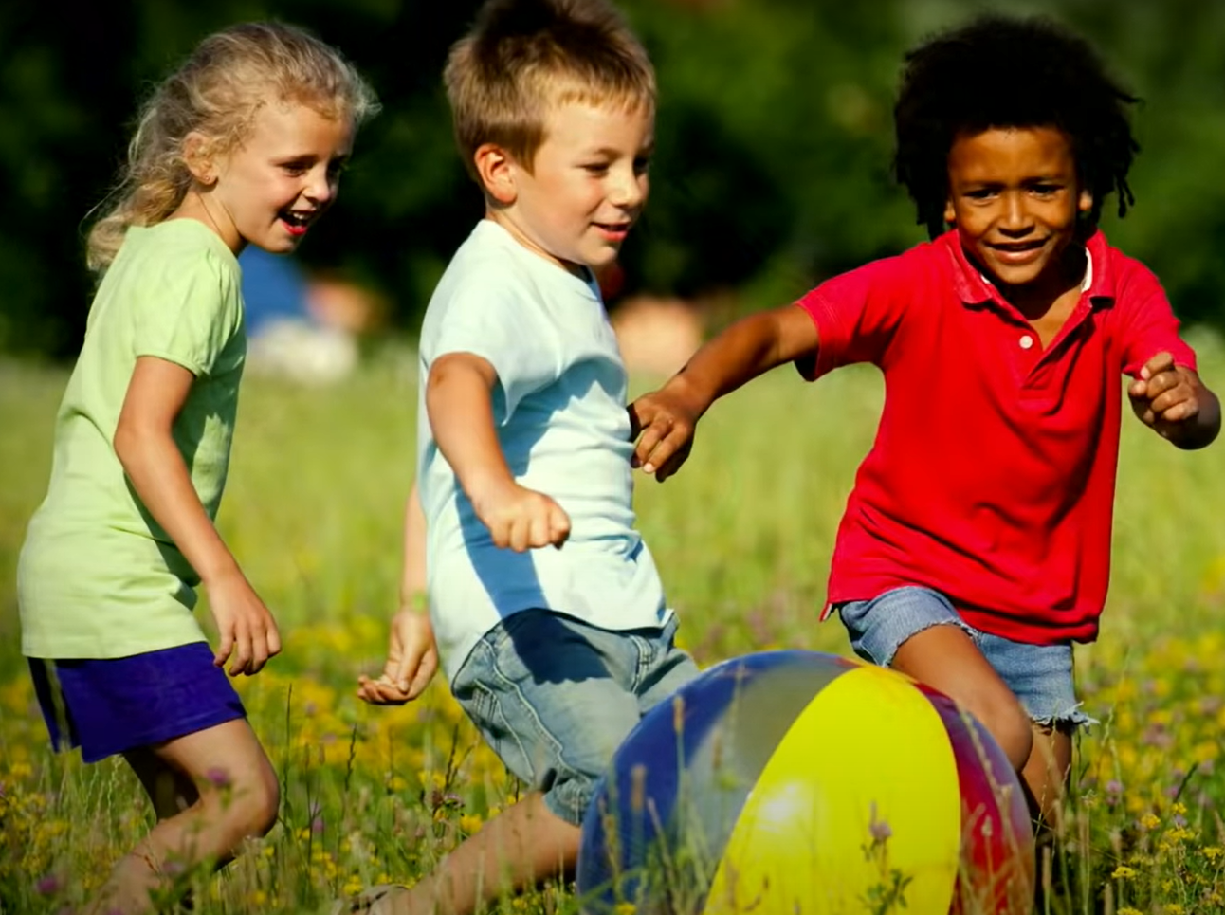
No one tells a child how to see
How we teach computers to understand pictures | Fei Fei Li https://www.youtube.com/watch?v=40riCqvRoMs&ab_channel=TED
Notes:
No one tells a child how to see, especially in the early years. Instead, they learn this through real-world experiences and examples.
Suppose you consider a child's eyes like a pair of biological cameras. In that case, they take one picture about every 200 milliseconds, the average time an eye movement is made.

Slide 5
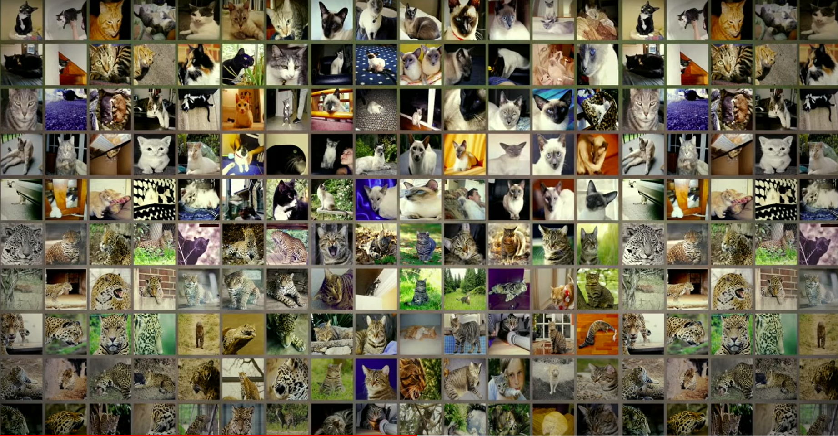
No one tells a child how to see
How we teach computers to understand pictures | Fei Fei Li https://www.youtube.com/watch?v=40riCqvRoMs&ab_channel=TED
Notes:
So, by age three, a child would have seen hundreds of millions of pictures of the real world.

Slide 6
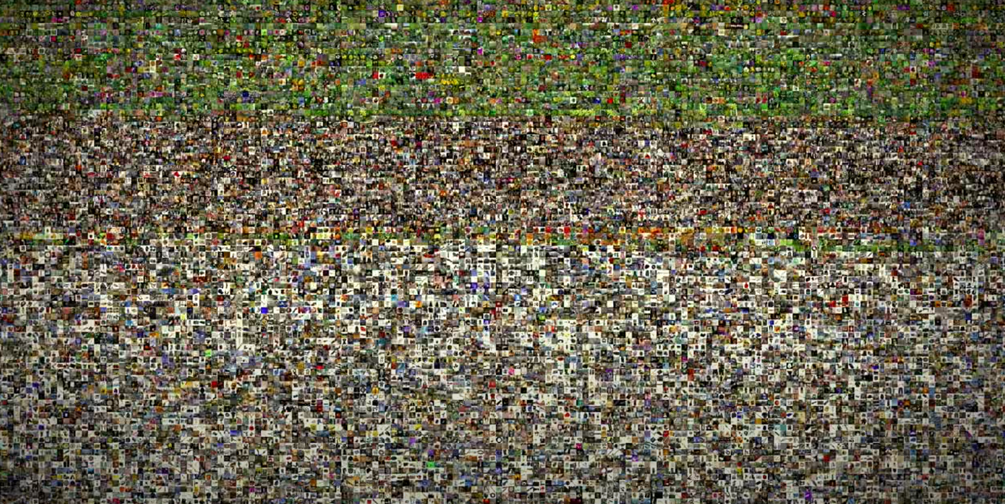
No one tells a child how to see
How we teach computers to understand pictures | Fei Fei Li
https://www.youtube.com/watch?v=40riCqvRoMs&ab_channel=TED
Notes:
That's a lot of training examples.

Slide 7
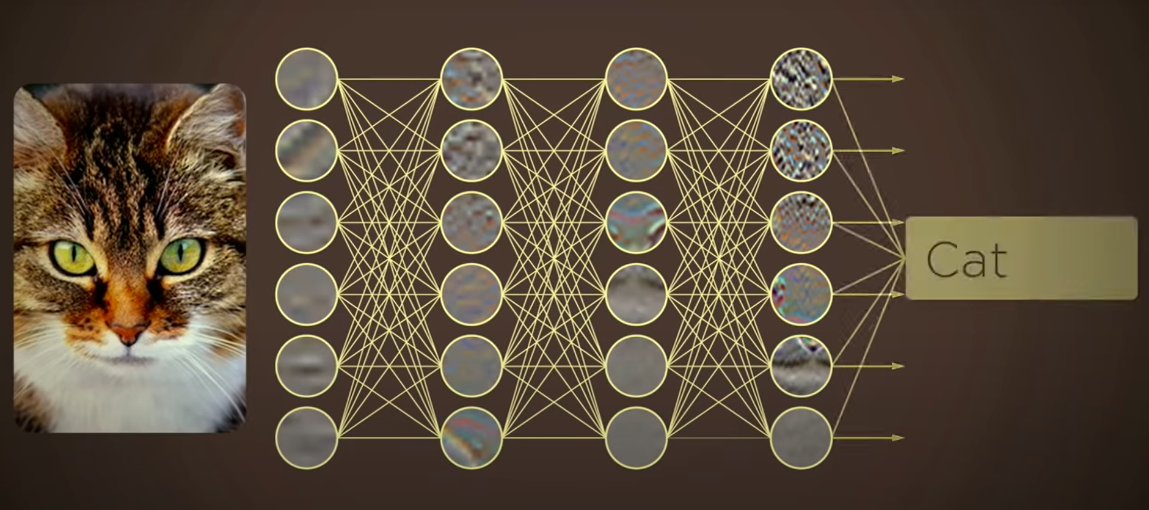
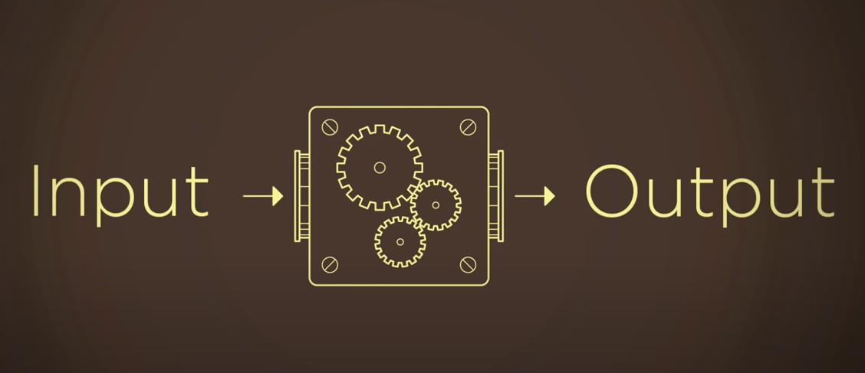
How to teach computer understand pictures?
How we teach computers to understand pictures | Fei Fei Li https://www.youtube.com/watch?v=40riCqvRoMs&ab_channel=TED
Notes:
So instead of focusing solely on better and better algorithms, the insight was to give the algorithms the kind of training data that a child was given through experiences in both quantity and quality.

Slide 8
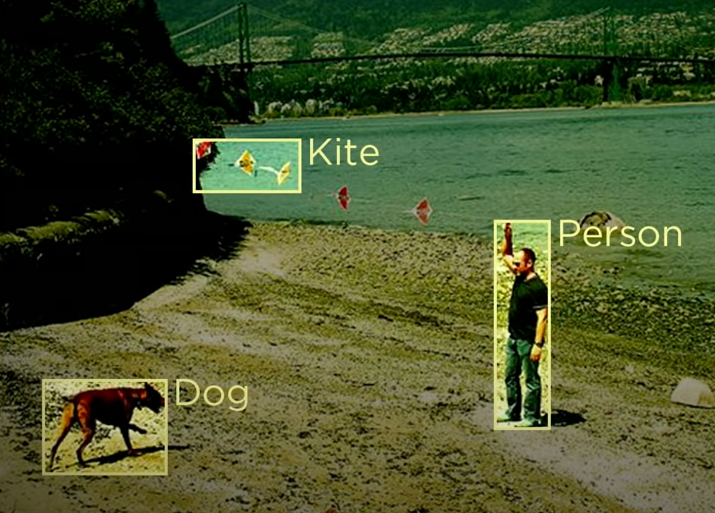
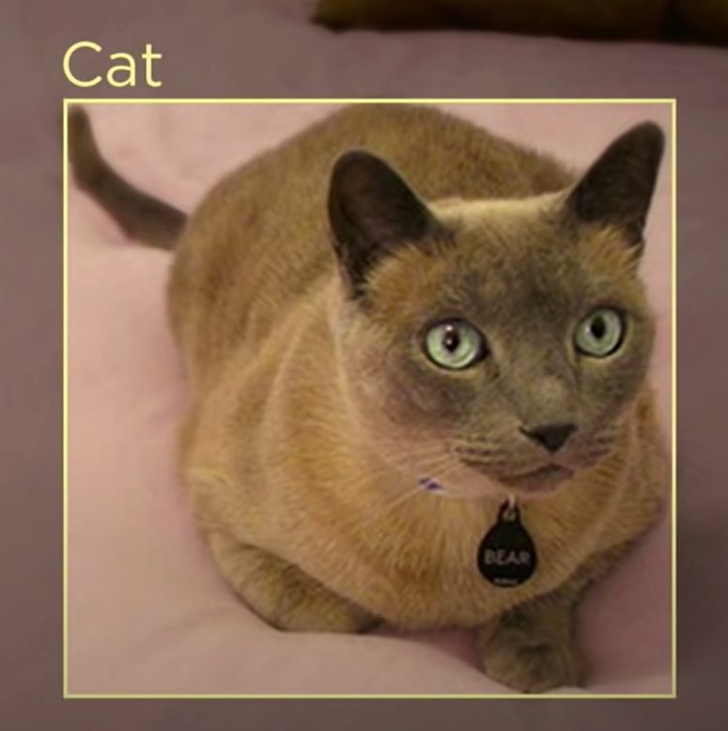
How we teach computers to understand pictures | Fei Fei Li https://www.youtube.com/watch?v=40riCqvRoMs&ab_channel=TED
Notes:
So ultimately, they want to teach the machines to see just like we do: naming objects, identifying people, inferring 3D geometry of things,understanding relations, emotions, actions, and intentions.

Slide 9
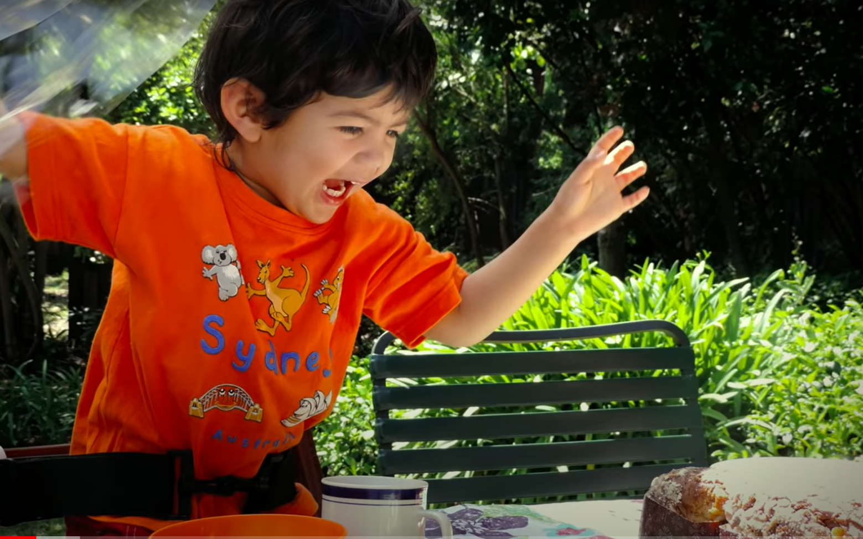
Conversing lights into a two-dimensional array
How we teach computers to understand pictures | Fei Fei Li https://www.youtube.com/watch?v=40riCqvRoMs&ab_channel=TED
Notes:
Cameras can take pictures like this one by converting lights into a two-dimensional array of numbers, known as pixels, but these are just lifeless numbers. They do not carry meaning in themselves. Because vision begins with the eyes but truly begins in the brain.

Slide 10
How to teach computers to understand pictures?
?
How we teach computers to understand pictures | Fei Fei Li https://www.youtube.com/watch?v=40riCqvRoMs&ab_channel=TED
Notes:
How to teach computers to understand pictures?
The first step towards this goal is to teach a computer to see objects, the building block of the visual world.

Slide 11
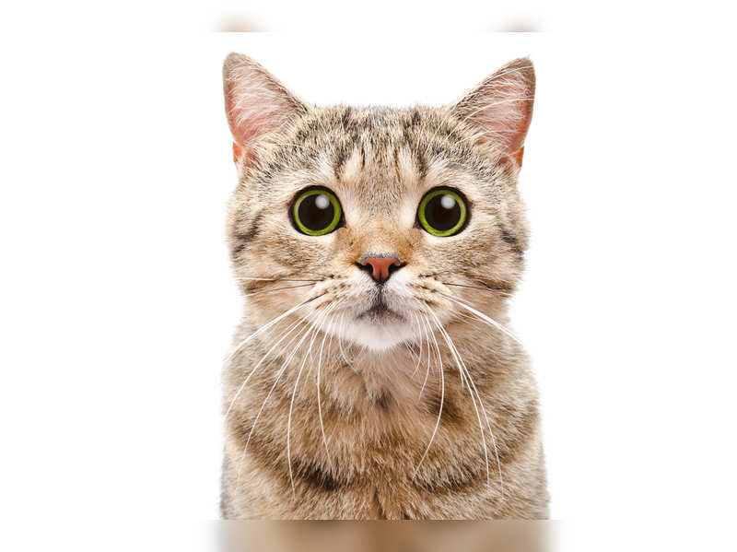
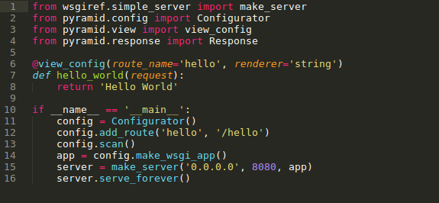
Design a model
CAT
Notes:
In its simplest terms, imagine this teaching process, as showing the computers some training images, of a particular object, and designing a model that learns from these training images.

Slide 12
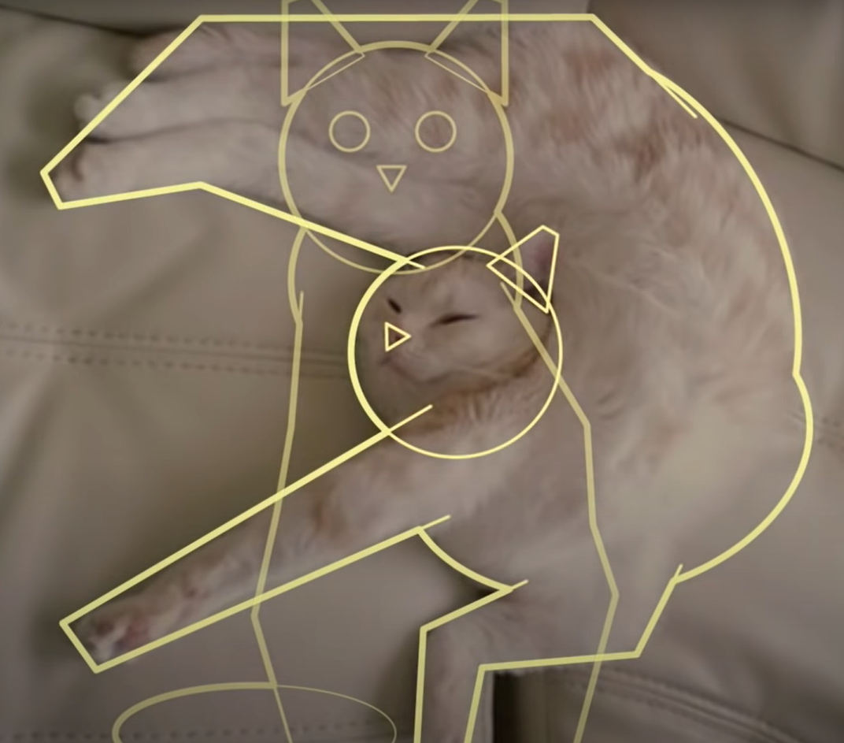
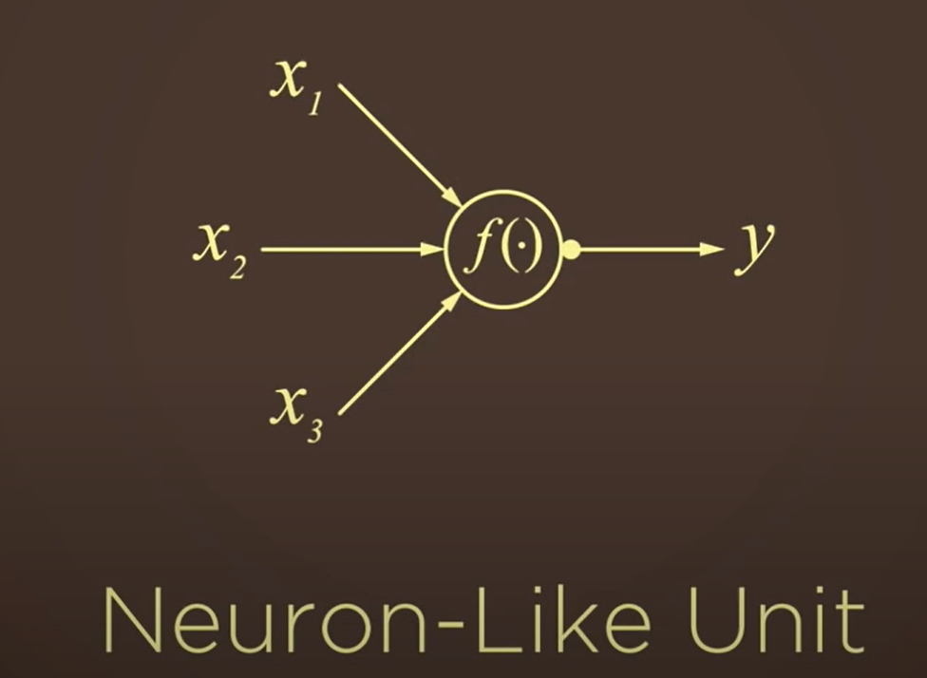
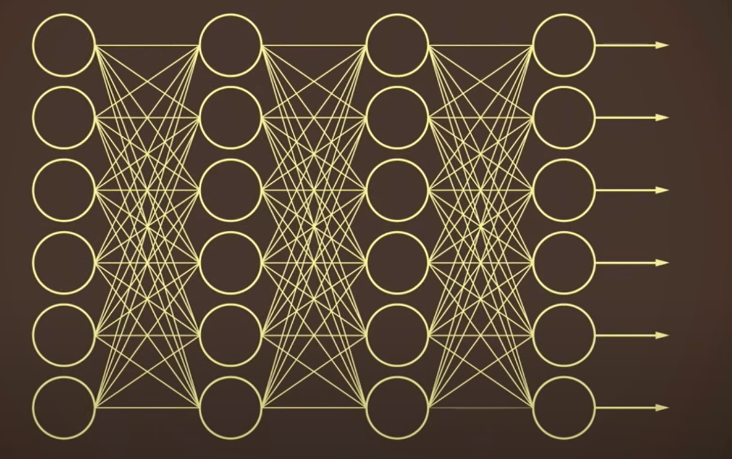
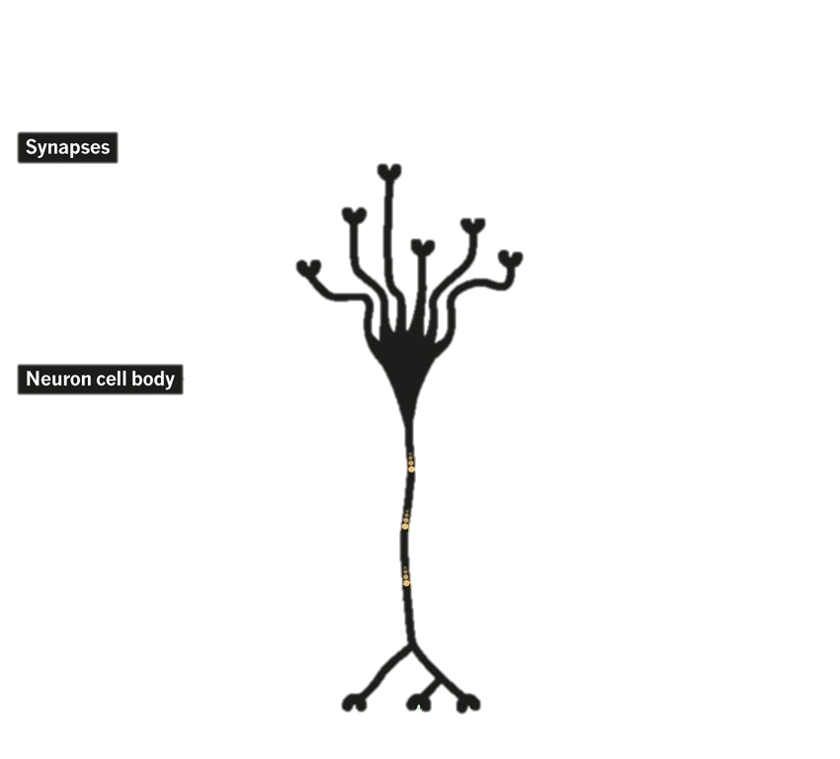
Tell the computer algorithm in a mathematical language
How we teach computers to understand pictures | Fei Fei Li https://www.youtube.com/watch?v=40riCqvRoMs&ab_channel=TED
Notes:
They would tell the computer algorithm in a mathematical language, that a cat has a round face, a chubby body, two pointy ears, and a long tail. Collect the shapes and colors.

Slide 13
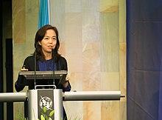
Collect a data set
Notes:
In 2007, Perf. Fei-Fei Li launched the ImageNet, collect the pictures form the internet.

Slide 14
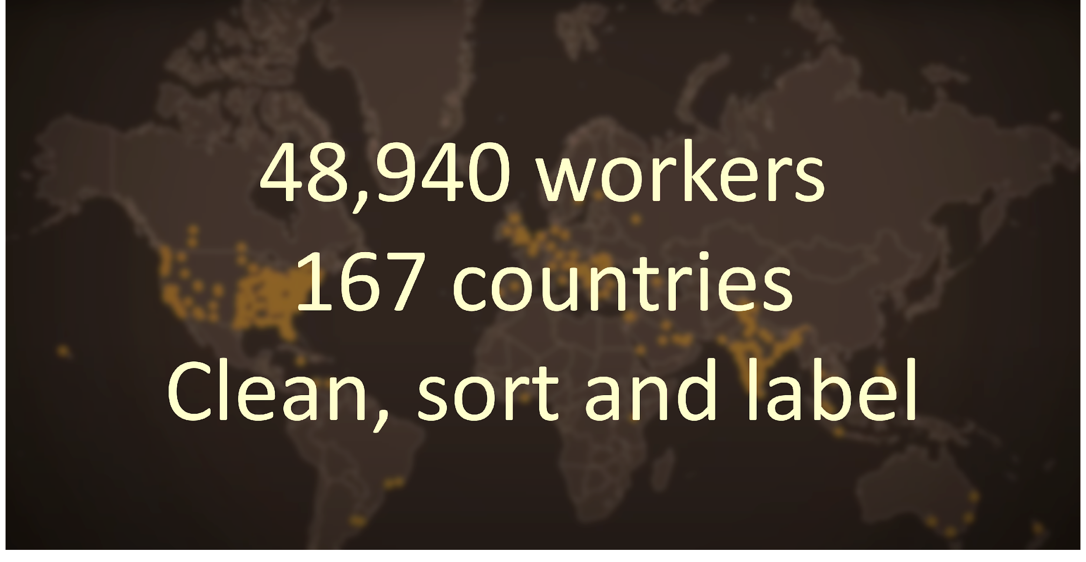
ImageNet
Notes:
At its peak, ImageNet was one of the Amazon Mechanical Turk workers; together, almost 50,000 works from 167 countries around the world helped them clean, sort, and label nearly a billion candidate images.

Slide 15
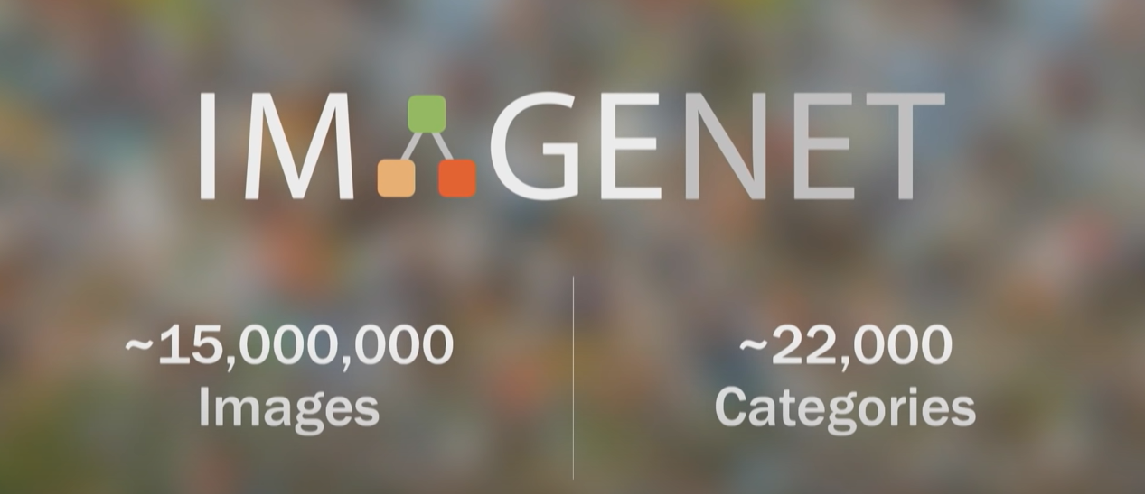
Collect a data set and Label the images
Notes:
In 2009, the ImageNet project delivered a database of 15 million images across 22,000 classes of objects and things organized by everyday English words. In both quantity and quality.
Now that they have the data to nourish their computer brain, and ready to come back to the algorithms themselves.

Slide 16
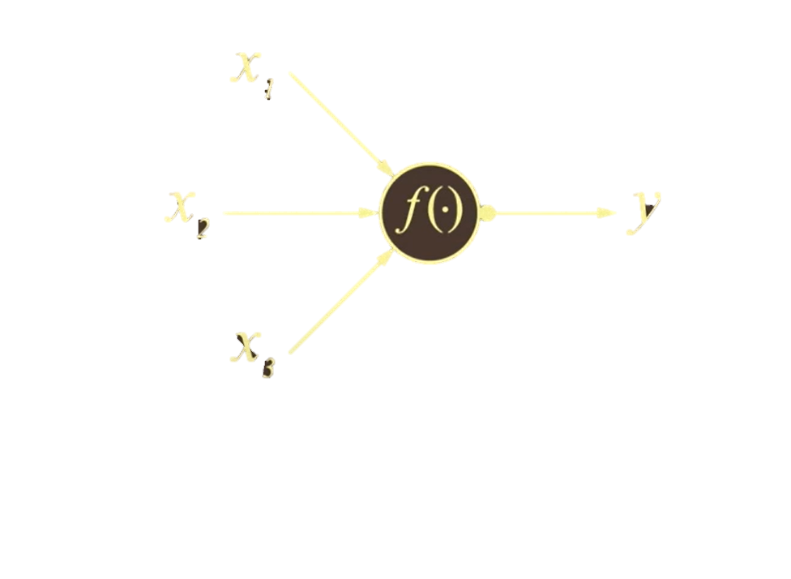
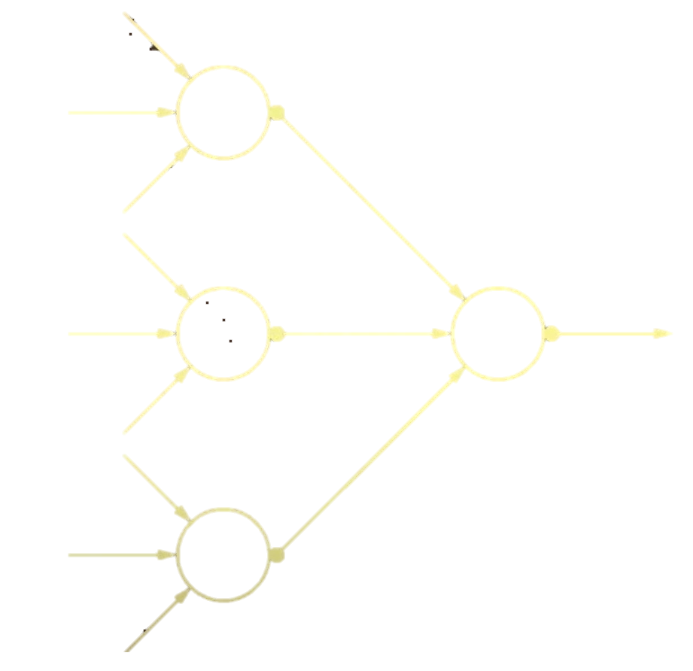
CNN model
24 million nodes,140 million parameters,15 billion connections
Neuron-like node
Convolutional Neural Network
Notes:
Just like the brain consists of billions of highly connected neurons, a basic operating unit in a neural network. It takes input from other nodes and sends output to others.

Slide 17
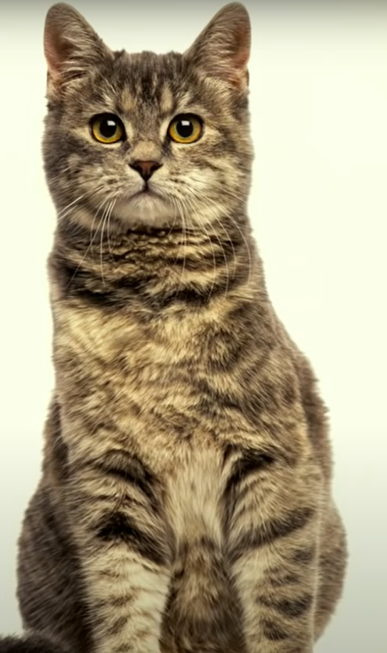
How to teach computer understand pictures?
How we teach computers to understand pictures | Fei Fei Li https://www.youtube.com/watch?v=40riCqvRoMs&ab_channel=TED
Notes:
Moreover, these hundreds of thousands or even millions of nodes are organized in hierarchical layers, also similar to the brain.

Slide 18
ILSVRC (ImageNet Large Scale Visual recognition challenge)
Notes:
In 2010, the ImageNet Challenge. This is significant because there are very few places that you can have machine learning and deep learning technologies to compare and compete to see which one is how much better than the other one.
This is very interesting and very rare.

Slide 19
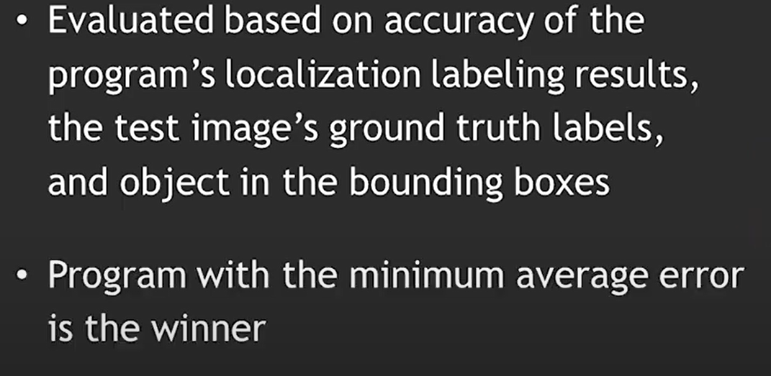
ILSVRC Large-scale object recognition capability
Detection
Computer-assisted detection (CADe)can mark suspicious lesions
https://www.youtube.com/watch?v=cMdnwKmgQ3o&ab_channel=Simplilearn
Notes:
The object category is classification and detection

Slide 20
Images & Videos
Diagnosis(CADx)
Present the shapes values
https://www.youtube.com/watch?v=cMdnwKmgQ3o&ab_channel=Simplilearn

Slide 21
https://www.youtube.com/watch?v=cMdnwKmgQ3o&ab_channel=Simplilearn

Slide 22
https://www.youtube.com/watch?v=cMdnwKmgQ3o&ab_channel=Simplilearn

Slide 23
https://www.youtube.com/watch?v=cMdnwKmgQ3o&ab_channel=Simplilearn

Slide 24
https://www.bulentsiyah.com/imagenet-winning-cnn-architectures-ilsvrc

Slide 25
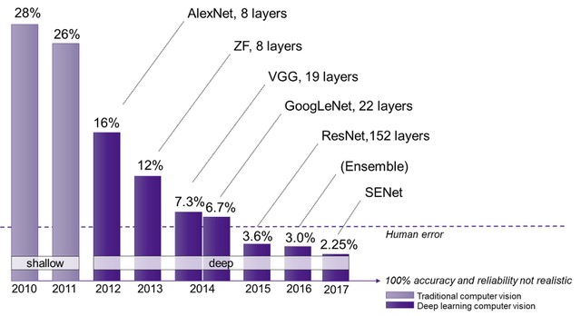
https://semiengineering.com/new-vision-technologies-for-real-world-applications/

Slide 26
If the content is King, then data is Queen. And together they make a formidable team.

Slide 27
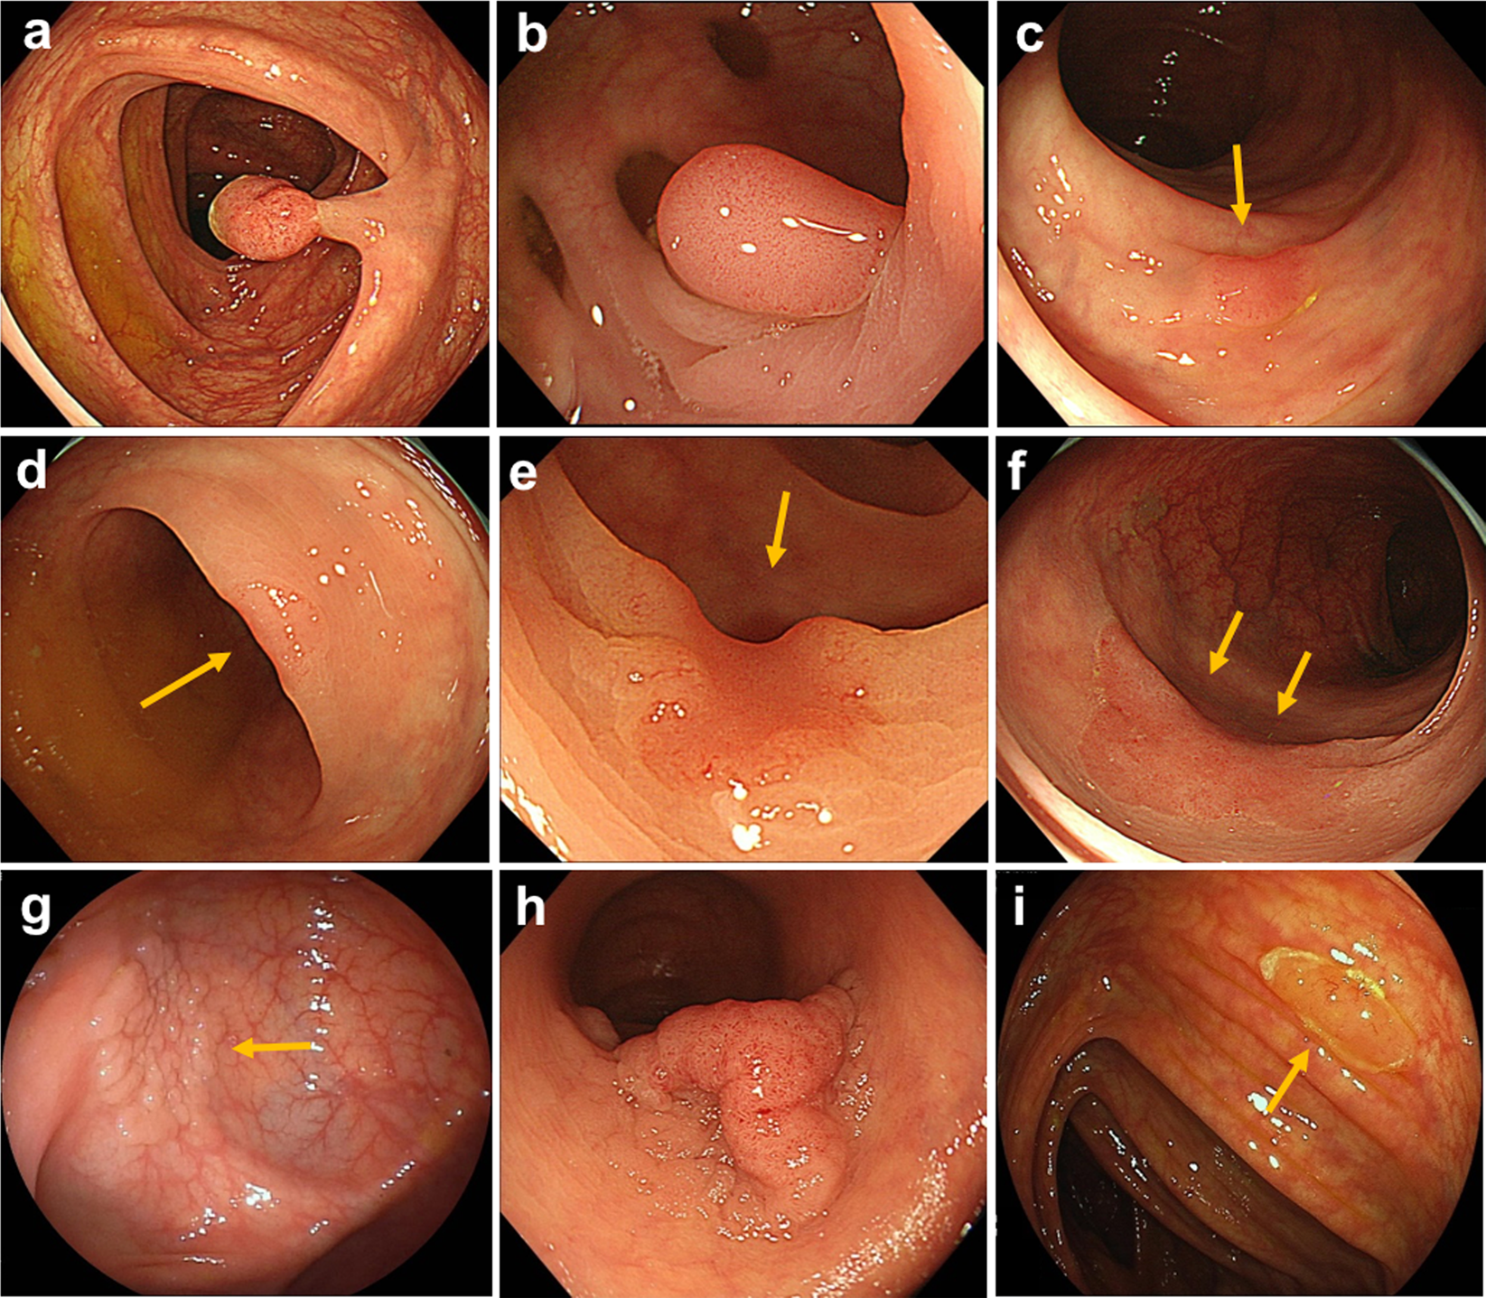
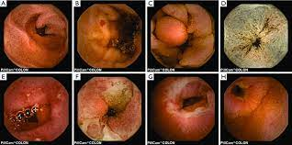
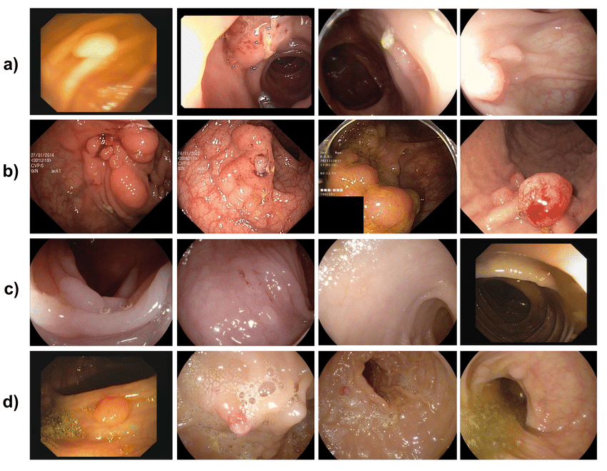
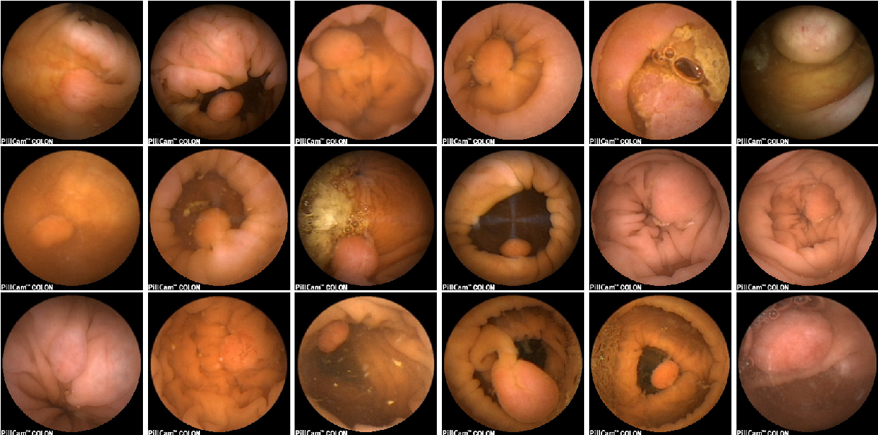
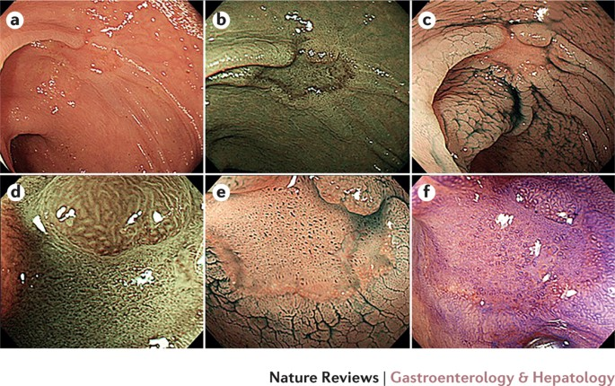
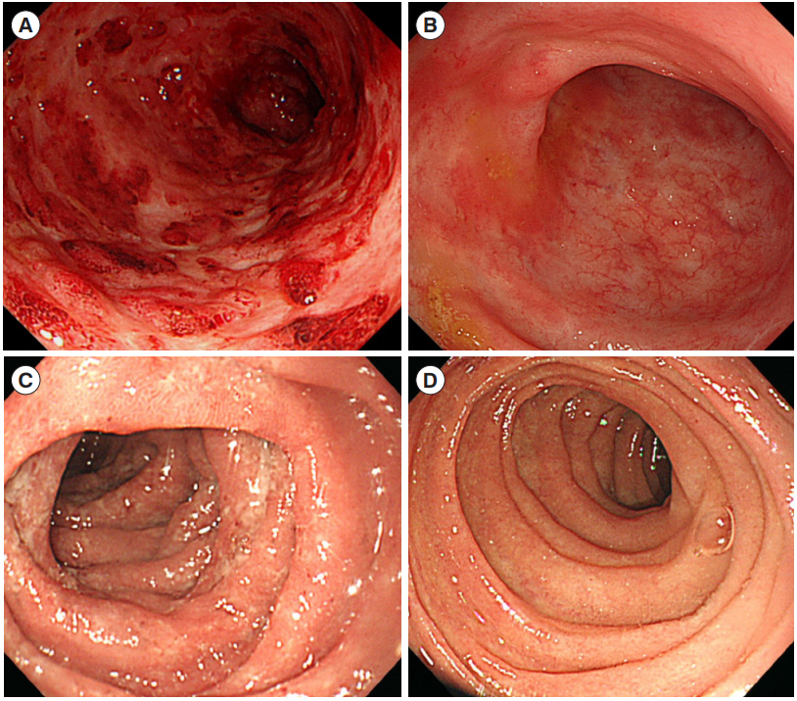
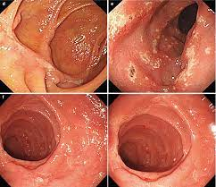
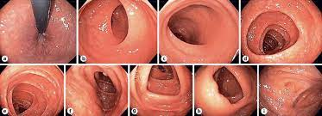
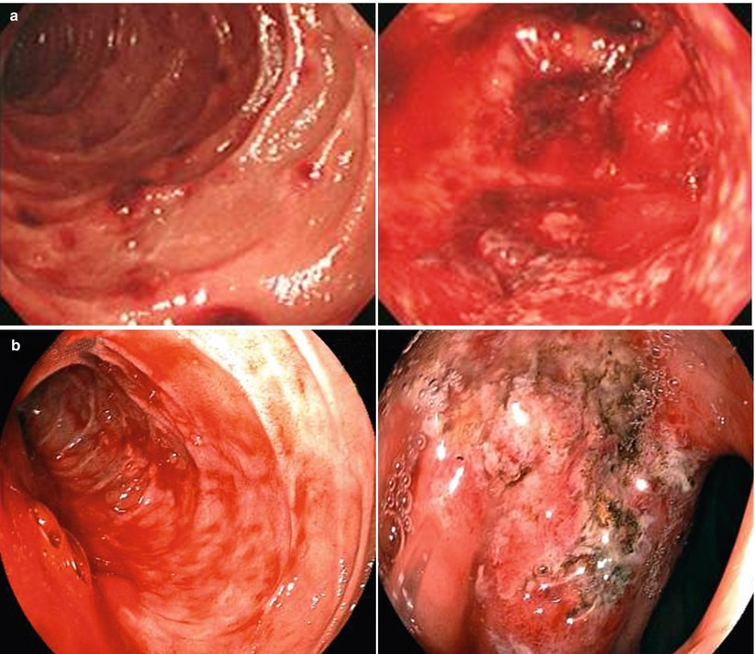
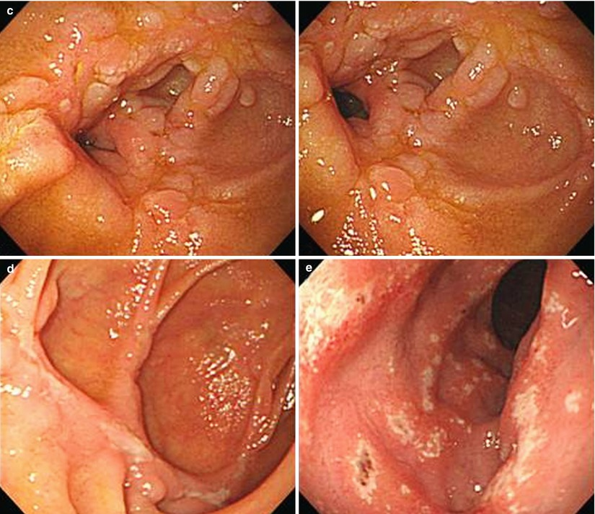
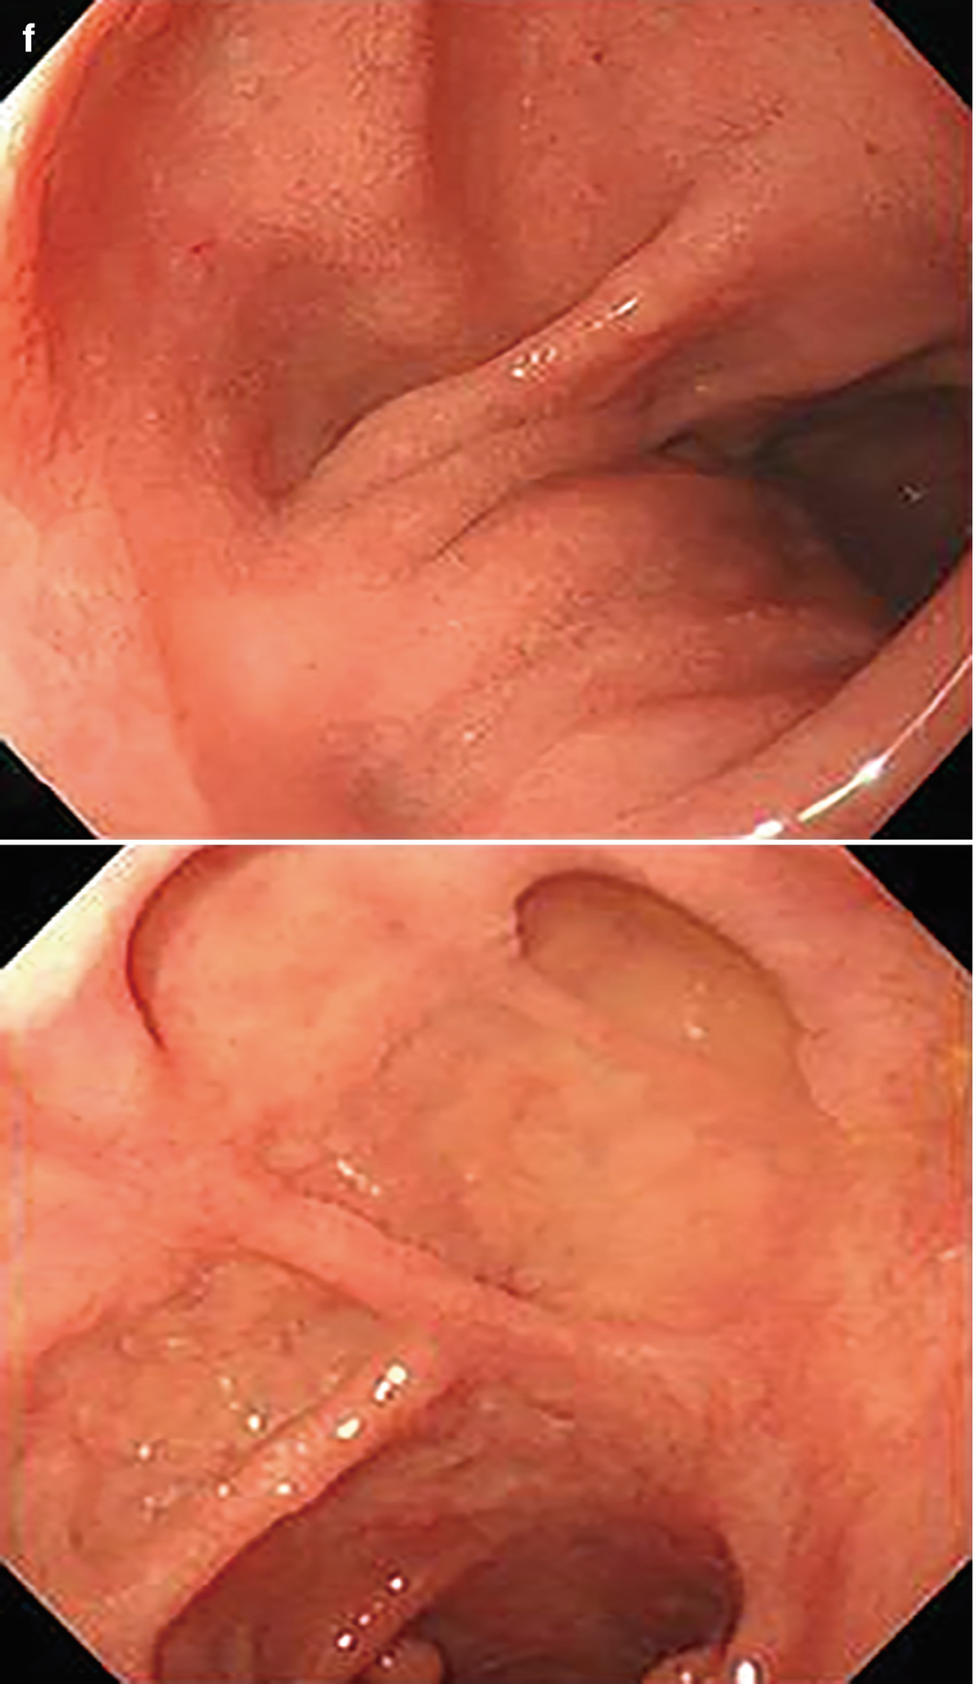
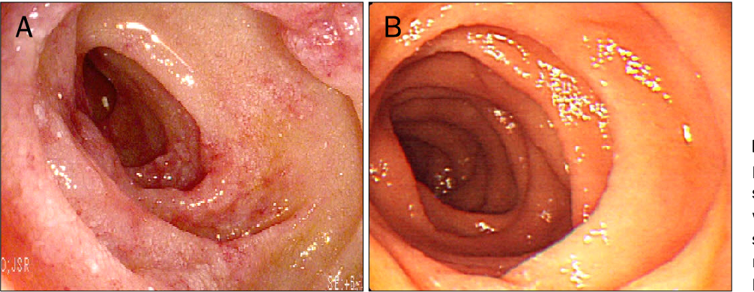
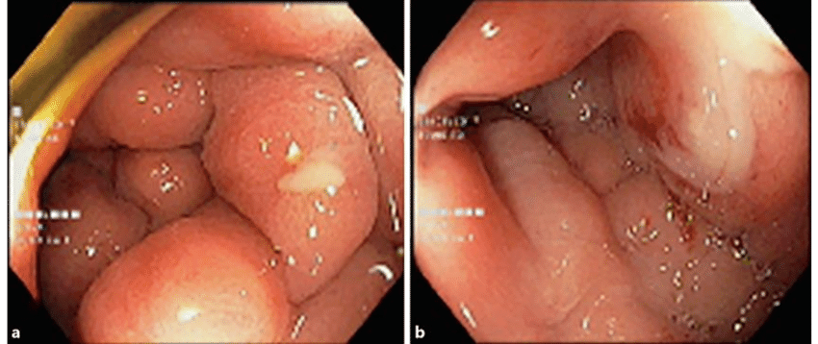
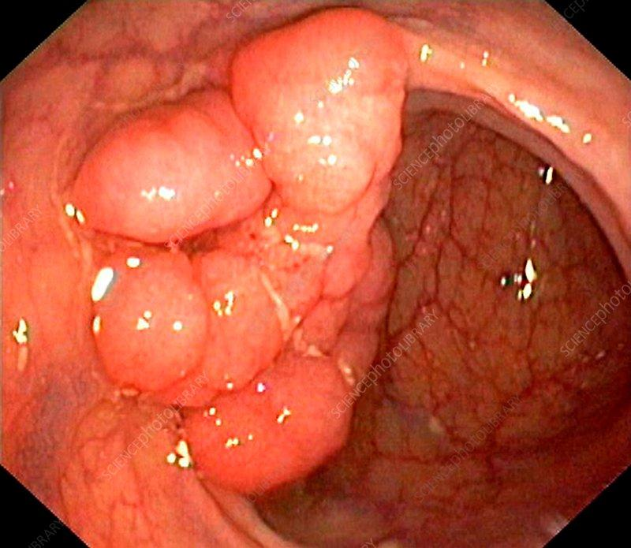
https://www.semanticscholar.org/paper/Polyp-Detection-and-Segmentation-from-Video-Capsule-Prasath/9a99af9495bab7f56278eff4f1ba04e63e8061f6/figure/0
Notes:
If we want to teach computers to understand polys or adenoma. The first step towards this goal is to teach a computer to see objects. Second, we need to collect data with far more images than we have ever had before, perhaps thousands of times more.

Slide 28
Clean, Sort, and Label
We need expert clinicians to help to clean, sort, and label nearly a hundred of thousands of candidate images.
Variability of appearance in colonic polyps under the video capsule endoscopy (VCE) imaging system
https://www.semanticscholar.org/paper/Polyp-Detection-and-Segmentation-from-Video-Capsule-Prasath/9a99af9495bab7f56278eff4f1ba04e63e8061f6/figure/0

Slide 29
Institutional Review Board (IRB)
The patient's images are protected by the Institutional Review Board (IRB). Every human research subject is recruited to participate in research activities conducted under the institution's auspices with which it is affiliated.

Slide 30
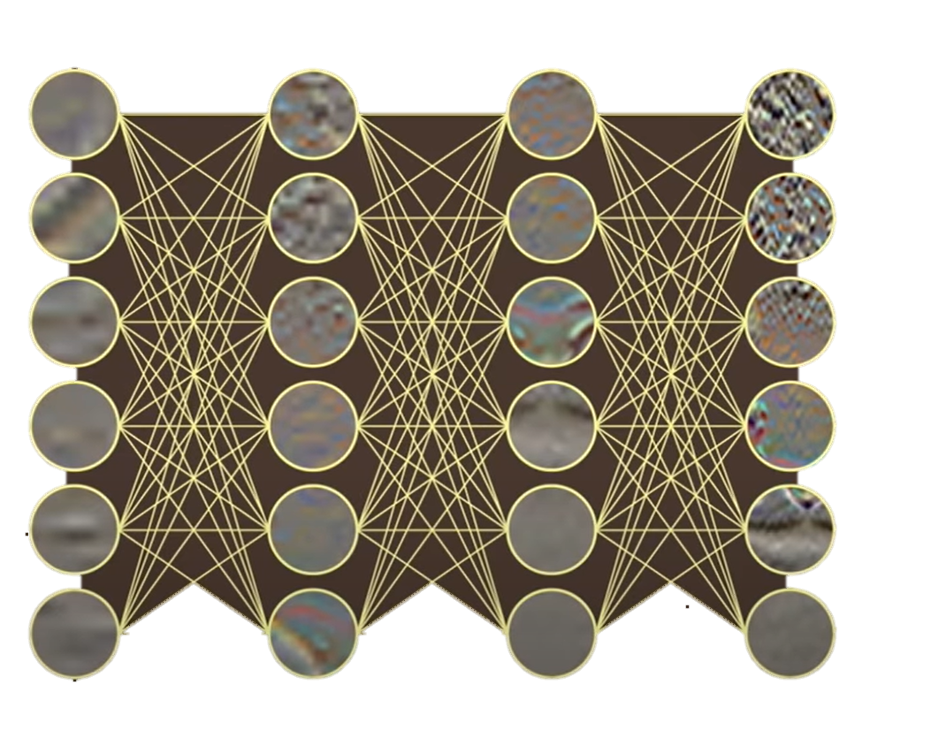
Up to 26% miss rates for polyps reported
Detection(CADe)
polypoid lesions
Diagnosis(CADx)
Type Polyp or Adenoma
Size
10-mm sized sessile type
https://www.nature.com/articles/s41598-019-50567-5
Notes:
As an example, in the case of cats, ImageNet database has more than 62,000 cats

Slide 31
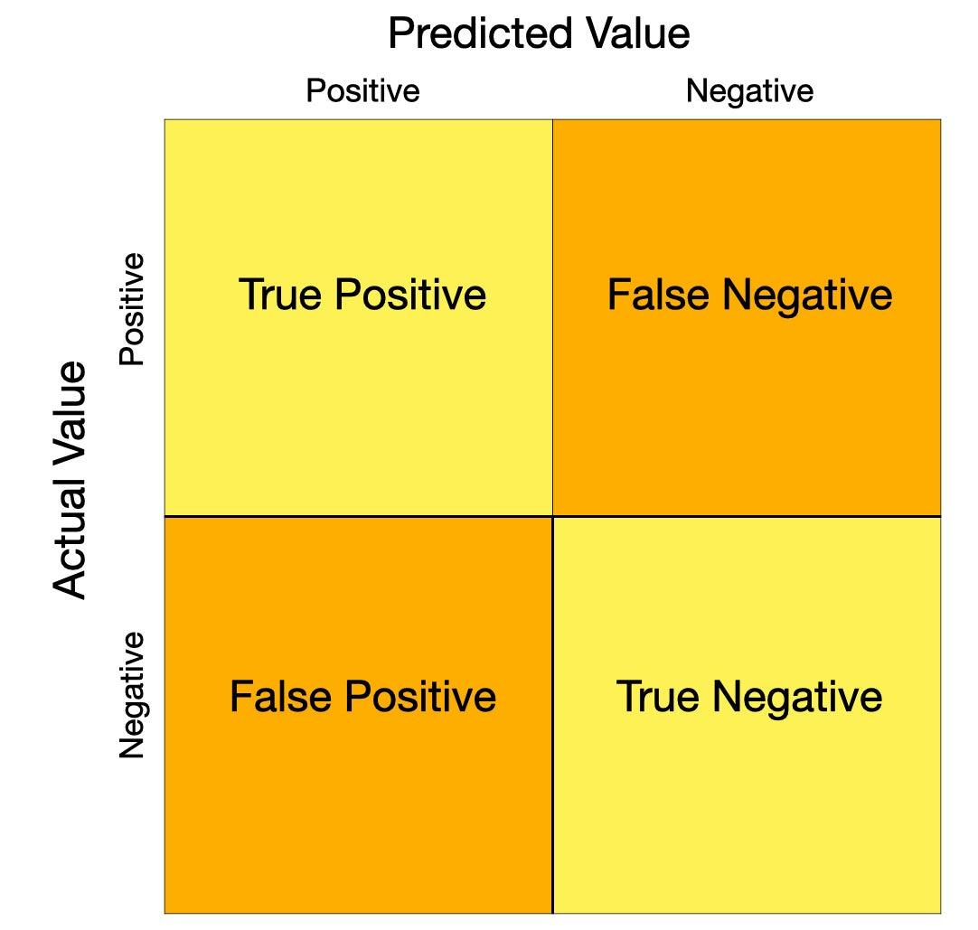
Software Overview and Algorithm Framework
SaMD: Software as medical device
Applications for the registration of SaMD for AI/ML technology should include a description of the software functionality and architecture and whether the software is designed with an adaptive or locked algorithm. based on the product’s intended use, effectiveness, indications, contraindications, and limitations.
The medical device firms should provide target functional values.
detection rate
false-positive rate
false-negative rate
testing time, and other necessary factors

Slide 32
CADe VS CADx
Adaptive/locked algorithm
Detection(CADe)- Class II
It can automatically extract suspicious lesions from images, mark their location by using AI/ML technology, analyze medical images and other medical test results to aid in the detection of lesions or abnormal values.
Diagnosis(CADx)- Class II/ Class III
It can automatically extract suspicious lesions from images and present their values or shapes as quantitative data through AI/ML techniques, providing diagnostic options and risk assessment results.

Slide 33
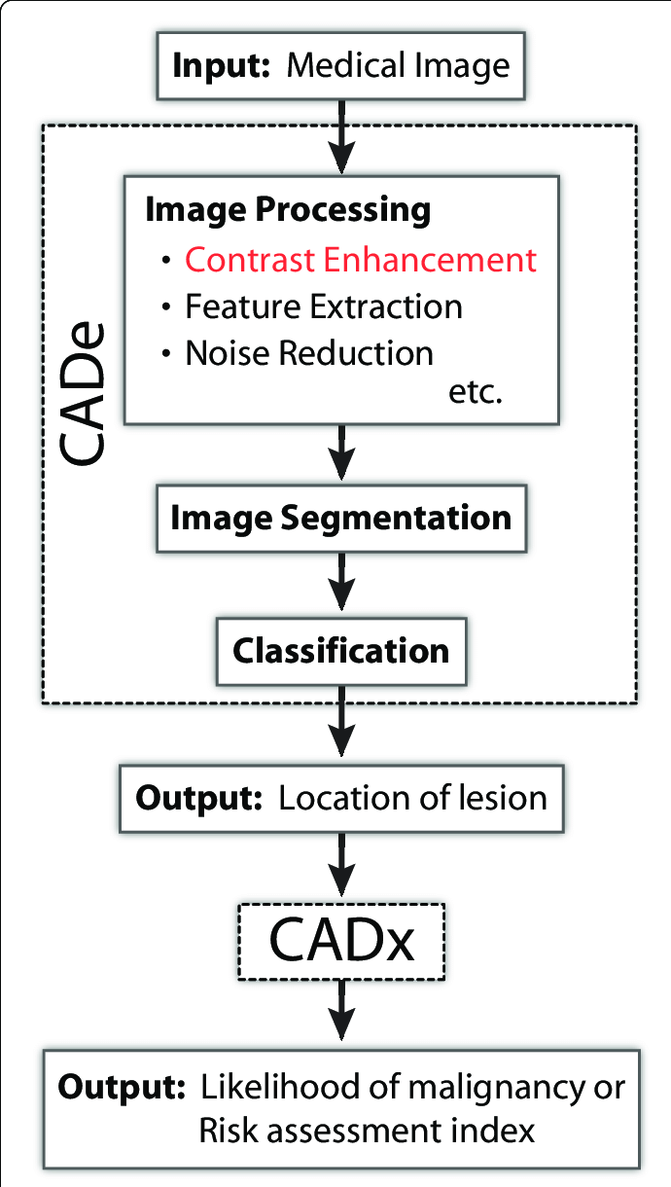
Schematic representation of typical CAD system
Detection(CADe)
Medical image
Locationof lesion
Diagnosis(CADx)
Location of lesion
Risk Assessment
Index
Kimori Y. Mathematical morphology-based approach to the enhancement of morphological features in medical images. J Clin Bioinforma. 2011 Dec 16;1:33. doi: 10.1186/2043-9113-1-33. PMID: 22177340; PMCID: PMC3275547.

Slide 34
Computer Aided Triage
Rapid screening for specific symptoms to help medical staff to reduce or eliminate requirements for the same clinical procedure (e.g., screening patients with acute cerebral hemorrhage).
Class III

Slide 35
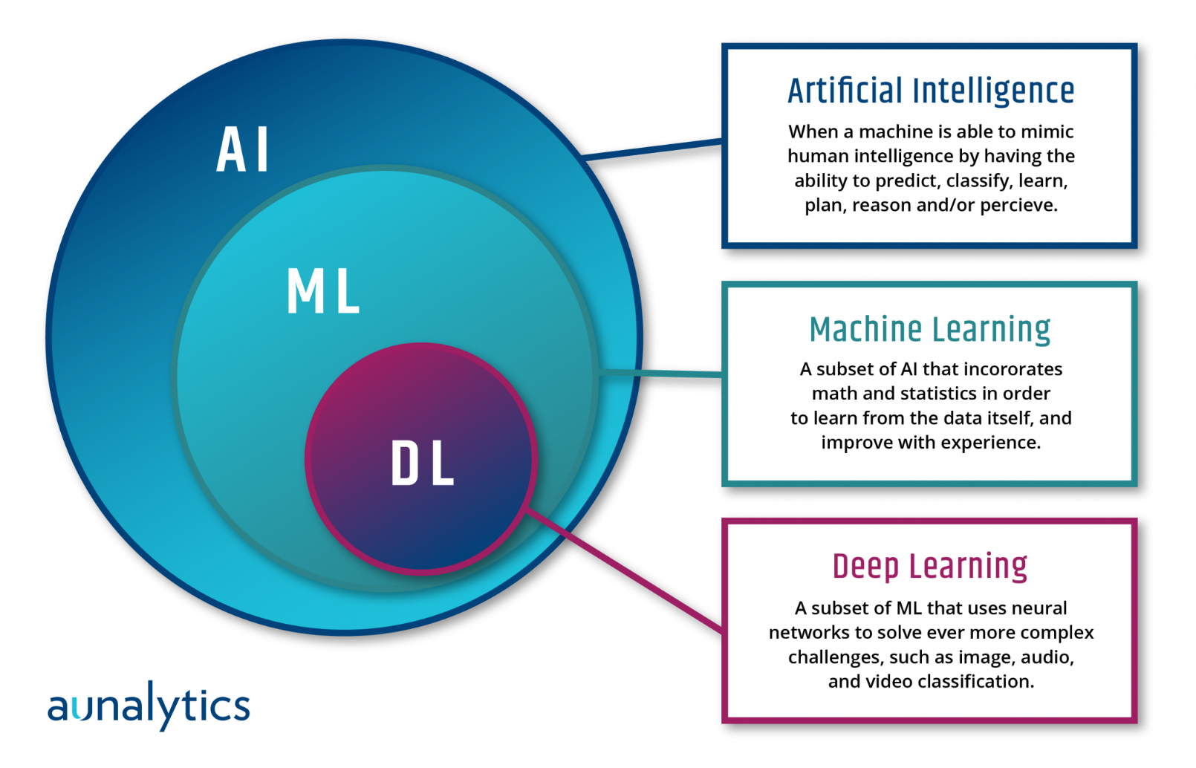
Terms and Definitions
AI: Simulate intelligent human behaviors and self-correction.
ML: computers /software can learn autonomously from data
DL: Using neural network structures, along with considerable training data, to learn features from these data.
Notes:
(1) Artificial Intelligence/Machine Learning (AI/ML):
Through scientific knowledge and engineering techniques, machines or computer programs can simulate intelligent human behaviors, such as “voice conversion, visual recognition, motor control, comprehension and learning, reasoning and decision-making, and self-correction”.
Machine learning is a subset of artificial intelligence. Through the design of algorithms and data training, computers (software) can learn autonomously from data without excessive programming and improve algorithms through training experience to simulate various computational methods of human learning functions, such as regression analysis, support vector machine, decision tree, and neural networks.
(2) Deep learning (DL):
It is a branch of ML that uses neural network structures (e.g., multilayer neural networks and convolutional neural networks), along with considerable training data, to learn features from these data.

Slide 38
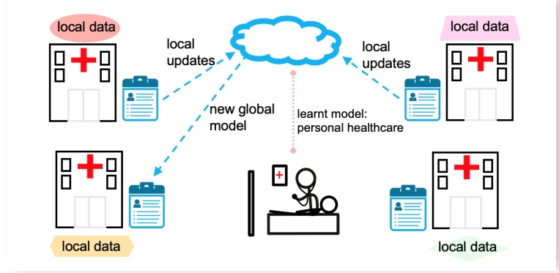
Federated learning
Cloud AI
Notes:
與傳統集中式的機器學習(ML)關鍵的差異在於，聯合式學習是在多個保存本地數據樣本而不會交換它們的去中心化邊緣裝置或伺服器上進行特定ML訓練，這可降低對隱私保護的疑慮以及能源消耗，因為數據不會移動到雲端或是中央資料庫。

Slide 39
file:///Users/chenweiling/Downloads/Tenshin_03.pdf

Slide 40
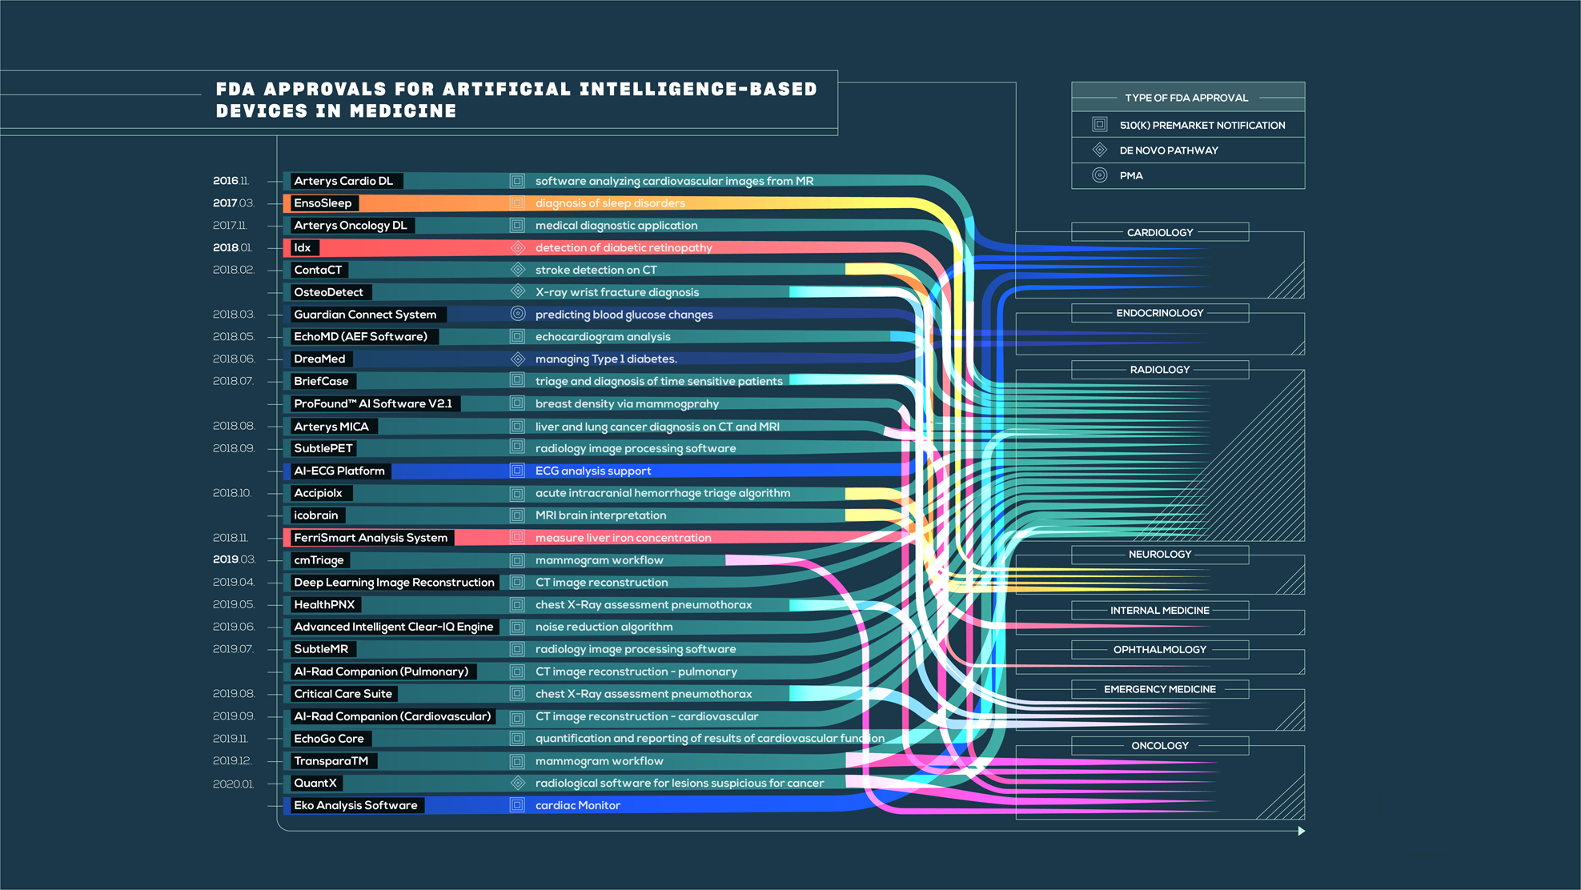
2016 / 11-
2020 / 1
https://www.nature.com/articles/s41746-020-00324-0
Notes:
On top of the rise in AI/ML-based algorithms, reports show a comparable increase in the global market size for AI/ML in healthcare. The value is projected to soon exceed US$28 billion from its 1 billion value in 2016. Software and devices using the technology will inevitably contribute to this market share.

Slide 41
GI Genius
In 2021, April
The first FDA-approved AI-base SaMD
in colonoscopy
Notes:
In 2021, 4/9, The US Food and Drug Administration (FDA) recently approved the marketing of the GI Genius, a system that is uses artificial intelligence (AI) technology to aid in the detection of potentially cancerous polyps during a colonoscopy. During a colonoscopy, the technology highlights portions of interest of the colon and generates markers which are superimposed onto the video generated by the colonoscope camera in real time.
With the FDA approval of the AI device, clinicians can now be equipped with a tool that can help to minimize the risk of missed colorectal polyps.

Slide 42
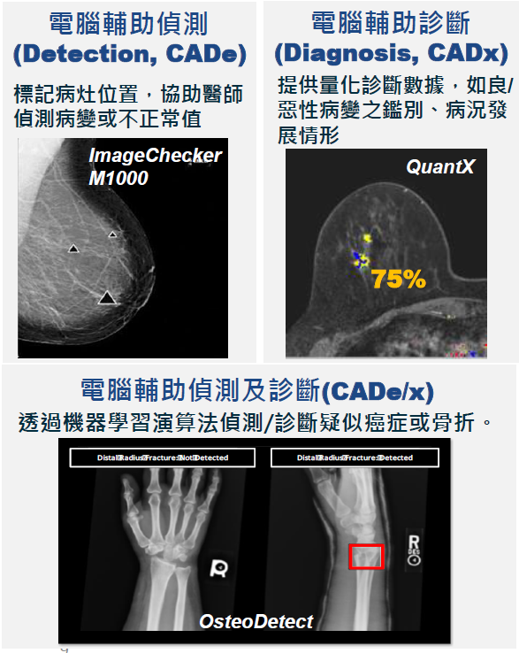
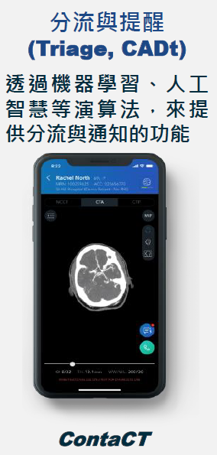
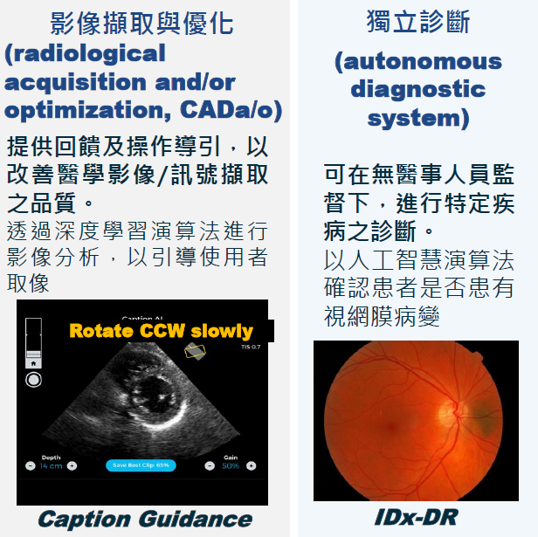
FDA-approved for AI-based device in medicine
Detection (CADe)
Diagnosis
(CADx)
Triage (CADt)
Radiological
Acquisition
Optimization
Autonomous
Diagnostic
system
CADe/x

Slide 43
First-FDA approved AI/ML-based diagnostic system
Retinal diagnostic sofeware device
Notes:
在預防糖尿病併發症的醫療過程中，視網膜健康的評估步驟還不需要勞動視網膜專家來篩檢病人，可以大幅增加病人篩檢率和降低專家醫療成本。對於偵測出糖尿病的視網膜病變，IDx-DR宣稱可達到87%的靈敏感度和90%的特異度

Slide 44
Notes:
FDA在2018年4月11日通過第一個人工智慧醫療 (AI-based device) – IDx-DR的上市，它利用人工智慧演算法分析由視網膜攝影機(Topcon NW400) 所獲得的影像，快速篩檢糖尿病病人是否有視網膜病變？IDx-DR可以在診療糖尿病人的一般醫療診所(primary care doctor’s office)擷取影像，將這些影像傳送到雲端分析，在1分鐘內就可以獲得判讀結果，陽性-指中度以上糖尿病視網膜病變(more than mild diabetic retinopathy, mtmDR)，就必須轉診眼科專家診治；陰性-則在1年後追蹤即可(下圖)。

Slide 48
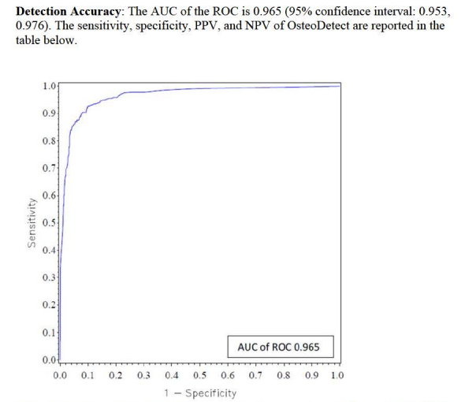
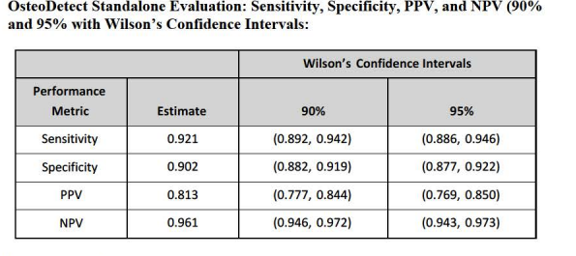

Slide 49
Thank you for attention
Nowadays, even one thousand algorithms do not replace a doctor. When machines can see, doctors will have extra pairs of tireless eyes to help them diagnose and take care of patients. The closer doctor-patient relationship not only gives a patient the attention that's needed but also comforts their heart.

