Slide 1
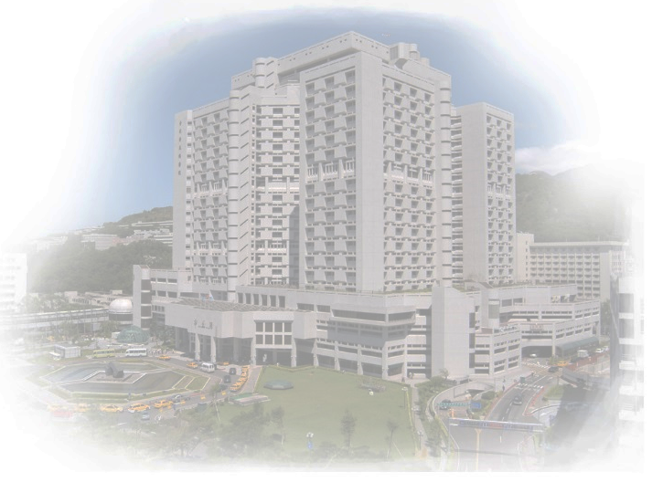
Taipei Veterans General Hospital

