Slide 1
Pathophysiology and mechanisms of radiopharmaceutical localization
胡蓮欣
20140915 morning meeting
The Pathophysiological basis of Nuclear Medicine 2nd ed. Springer.

Slide 2
The mechanisms of radioisotope localization
In vivo, MUGA, RBC scan
Isotope dilution
Capillary blockade
Physicochemical adsorption
Cellular migration and sequestration
Membrane transport
Simple diffusion
Diffusion and intracellular metabolism/binding
Diffusion and mitochondrial binding
Diffusion and increased capillary and plasma membrane permeability
Facilitated diffusion
Active transport
Phagocytosis
Receptor-mediated endocytosis
Metabolic Substrates and Precursors
Precursors: Radiolabeled Amino Acids
Tissue Hypoxia
MAA lung perfusion
MDP bone scan
WBC scan, denatured RBC spleen scan
Xe-133 ventilation
HMPAO/ECD brain perfusion scan
Tc-99m MIBI
Gallium
FDG, IDA derivatives
Radioiodine, pertecnetate, TlCl, Rb +
SC
Gallium
FDG
Amino acids
F-MISO

Slide 3
Cell Proliferation
Specific Receptor Binding
Radiolabeled Peptides
Steroid Hormone Receptors
Adrenergic Presynaptic Receptors and Storage
LDL Receptors
Radiolabeled Antibodies
Imaging Gene Expression
Ribonucleic acids, ex: F-18 FLT
SST analogues, VIP

Slide 4
Specific Receptor Binding
Radiolabeled Peptides
SST receptors
VIP receptors
Steroid Hormone Receptors
Adrenergic Presynaptic Receptors and Storage
LDL Receptors
Radiolabeled Antibodies

Slide 5
Specific Receptor Binding— Steroid hormone receptors
Steroid, cholesterol, adrenocortical hormones
Application of steroid hormone imaging agents
Breast cancer
ER & PR agents
16α-F-18 fluoro-17β-estradiol (FES): ER
21-F-18 fluoro-16α-ethyl-19-norprogesterone (FENP): PR
I-123 cis-11β-methoxy-17α-iodovinylestradiol (Z-[ 123 I]MIVE): ER, in breast cancer
→ Passive diffusion, bind to steroid receptors in the nucleus

Slide 6
Steroid, cholesterol & adrenocortical hormones
Steroid
An organic compound of a characteristic four cycloalkane rings
Cycloalkane 環烷烴
Cyclic alkane (通式: C_{n}H_{2(n+1-g}, n: 碳原子個數, g: 環數)
Alkane 烷烴
A saturated hydrocarbon compound, consisting only of hydrogen and carbon atoms and all bonds are single bonds. (通式: C_{n}H_{2n+2}，n: 碳原子個數)
Methane 甲烷, Ethane 乙烷, Propane 丙烷, Butane 丁烷, Pentane 戊烷, Hexane 己烷…
一類化合物
直鏈烷與環烷，相對應的命名
Propane 環丙烷, Butane 環丁烷, Pentane環戊烷, Hexane 環己烷
from: Wikipedia, Steroid/ Cycloalkane/ Alkane

Slide 7
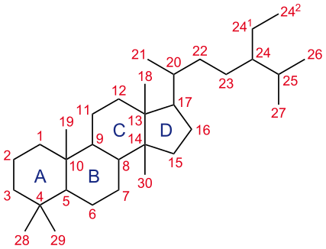
Steroid, cholesterol & adrenocortical hormones
Steroid (cont.)
17 carbon, four cycloalkane: three cyclohexane rings (A, B and C rings) and one cyclopentane ring (the D ring)
Examples of steroid:
Lipid cholesterol
Sex hormones (estradiol, testosterone)
Bile acids
Drugs (ex: dexamethasone)
from: Wikipedia, Steroid/ Cycloalkane/ Alkane

Slide 8
Steroid, cholesterol & adrenocortical hormones
Sterol (a.k.a. steroid alcohols) 甾醇
A subgroup of steroids with an -OH group at the 3-position of the A-ring
occur naturally in plants, animals, and fungi, with the most familiar type of animal sterol being cholesterol
Cholesterol
It is a sterol and is biosynthesized by all animal cells because it is an essential structural component of animal cell membranes that is required to maintain both membrane structural integrity and fluidity
C-17: functional group
Precursors of sex hormones
一類化合物
一種化合物
from: Wikipedia, choleterol, steroid

Slide 9
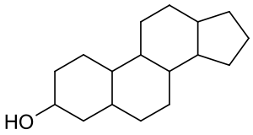
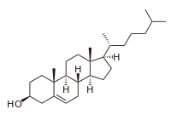
Sterol
Cholesterol
17
3
3
from: Wikipedia, choleterol, steroid

Slide 10
Relationship between:
Steroid, cholesterol and adrenocortical hormones
from: Estrella Moutain Community college
Notes:
http://www2.estrellamountain.edu/faculty/farabee/biobk/biobookendocr.html

Slide 11
Zona
glomerulosa
progesterone
Zona
fasciculata
Zona
reticularis
(DHEA)
estrogen
(DHT)
From: Wikipedia, steroid

Slide 12
[F-18] FENP
Z-[ 123 I]MIVE
ER
PR
ER
F-18 FES PET
Potential for detecting ER(+) metastatic foci of breast ca.
SPECT

Slide 13
Specific Receptor Binding— Adrenergic presynaptic receptors & storage
脫羧
APUD: amine precursor uptake and decarboxylation
a group of cells of common embryonic origin that secrete most of the body's hormones, with the exception of steroids. APUD cells comprise both specialized neurons and other endocrine cells. These cells synthesize structurally related polypeptides and biogenic amines. The acronym APUD derives from the fact that polypeptide production is linked to the uptake of a precursor amino acid and its decarboxylation in the cell to produce an amine.
Peptide hormones , ex: insulin, ACTH, glucagon and antidiuretic hormone
Amine hormones ,ex: dopamine, norepinephrine, serotonin and histamine
From: Answers.com
Notes:
http://www.answers.com/topic/apud-cell

Slide 14
APUD system
A morphologic and functional subgroup of the endocrine system, encompassing:
C-cells of the thyroid
Type-I cells of the carotid body and paraganglia
Norepinephrine and epinephrine-producing cells of the adrenal medulla
Melanoblasts
Pineal gland
Posterior pituitary cells
APUD cells take up tryptophan, converting it to 5-HT (serotonin), which is converted to mono-amine oxidase (MAO) 5HIAA
The term APUD system is little used in the working parlance and has been replaced by neuroendocrine system
→ release noradrenalin
From: The Free Dictionary by FARLEX
Notes:
http://medical-dictionary.thefreedictionary.com/APUD+system

Slide 15
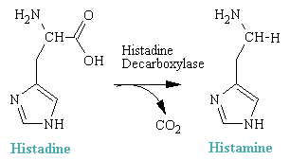
Notes:
Serotonin and dopamine biosynthetic pathways. Serotonin and dopamine are synthesized from the aromatic amino acids tryptophan and tyrosine, respectively. The first and rate-limiting step in synthesis is carried out by a neurotransmitter-specific aromatic amino acid hydroxylase enzyme, either tryptophan or tyrosine hydroxylase. In C. elegans, these genes are encoded by the tph-1 and cat-2 genes, respectively [19, 25]. The second synthetic step for both neurotransmitters shares the aromatic L-amino acid decarboxylase (AADC) enzyme, which has a relatively broad substrate specificity, and is also known as 5-hydroxytryptophan decarboxylase or dopa decarboxylase.
Hare and Loer BMC Evolutionary Biology 2004 4:24 doi:10.1186/1471-2148-4-24
http://www.biomedcentral.com/1471-2148/4/24/figure/F1
http://faculty.weber.edu/ewalker/Medicinal_Chemistry/topics/Antihistam_local_anesth/antihista.htm

Slide 16
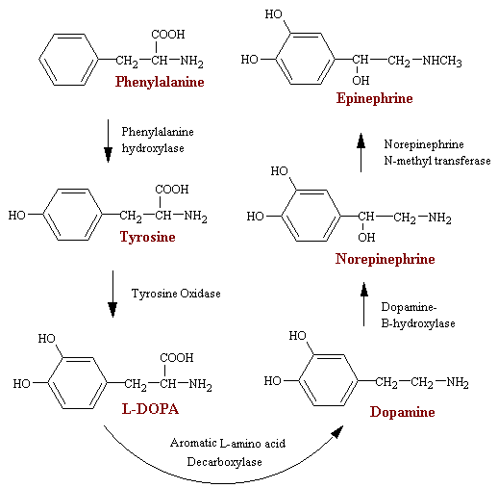
Notes:
http://faculty.weber.edu/ewalker/Medicinal_Chemistry/topics/Adrenergic/adrenerg.htm

Slide 17
Specific Receptor Binding— Adrenergic presynaptic recptors & storage
I-131 meta-iodobenzyl-guanidine (I-131 MIBG)
An analog of noradrenaline
accumulate in catecholamine storing chromophil cells of adrenal medulla
is believed to be transported into the cell by the reuptake pathways of the adrenergic presynaptic neurons. Within the cells, MIBG is transported into the catecholamine-storing granules by means of the ATPase-dependent proton pump. The major difference bt MIBG and noradrenaline is that MIBG dose not bind to postsynaptic adrenergic receptors
Reduced uptake if using: labetalol, CCBs, antipsychotic & sympathomimetic agents
MIBG因為結構類似 norepinephrine，必須緩慢注射以免引起高血壓的危險性。藥物注射後，建議請受檢者在檢查室休息半小時後，無異狀再離開___ CGMH protocol
Notes:
http://kelwww.cgmh-mi.com/examnm/i-131-mibg-scan

Slide 18
Specific Receptor Binding— Adrenergic presynaptic recptors & storage
I-131 meta-iodobenzyl-guanidine (I-131 MIBG) (cont.)
Pheochromocytoma… from adrenal medulla
Paraganglioma (extra-adrenal pheochromocytoma)… extra-adrenal adrenergic system (special chemoreceptors, chiefly in carotid body, aortic body and may also be located along major arteries)
Medullary thyroid carcinoma
Retinoblastoma
Melanoma
Bronchial carcinoma
initially, used in…
From:
The American Association of Endocrine Surgeons
Patient Education Site
Paraganglioma
laterally, used in…

Slide 19
Possible sites of Paraganglioma
Artwork by
Elizabeth Chabot
From:
The American Association of Endocrine Surgeons
Patient Education Site
Paraganglioma
Notes:
http://endocrinediseases.org/adrenal/paraganglioma.shtml

Slide 20
Specific Receptor Binding— LDL recptors
131 I-6β-iodomethyl-19-norcholesterol (NP-59)
131 I-6-iodocholesterol (Ioderin)
75 Se-β-iodomethyl-19-norcholesterol (Scintadren)
Mechanism of uptake:
transported by plasma LDL and are accumulated in the adrenal cortex via LDL receptors
esterified like cholesterol and stored intracellularly without further metabolism or incorporation into adrenocortical steroid hormones

Slide 21
NP-59 Adrenal Cortical Scintigraphy
利用NP-59檢查時有不同的步驟:
當懷疑是庫辛氏症時直接注射NP-59檢查即可，藉著影像表現的不同來判斷是ACTH依賴型或是非依賴型
若懷疑是原發性醛固酮過多症則必須先以dexamethasone(DS)進行抑制ACTH分泌再注射NP-59
適應症: 1、診斷原發性醛固酮過多症是腺瘤或是腎上腺皮質增生所引起 2、當CT、MRI、超音波發現腎上腺有腫塊時可以鑑定腫塊的功能及特性 3、診斷庫辛氏症(Cushing's syndrome)是ACTH依賴型或是非依賴型 4、診斷女性多毛症或無月經是否因腎上腺雄性素分泌過高引起
From: Green kid
Notes:
http://www.greenkid.idv.tw/NM/NP59/NP59.htm

Slide 22
Thanks your attention.

