Slide 1
CHROMOSOME ABNORMALITOES AND GENETIC COUNSELINGS
Presenter: R2 張家甄
Supervisor: Fellow 楊思婷醫師

Slide 2
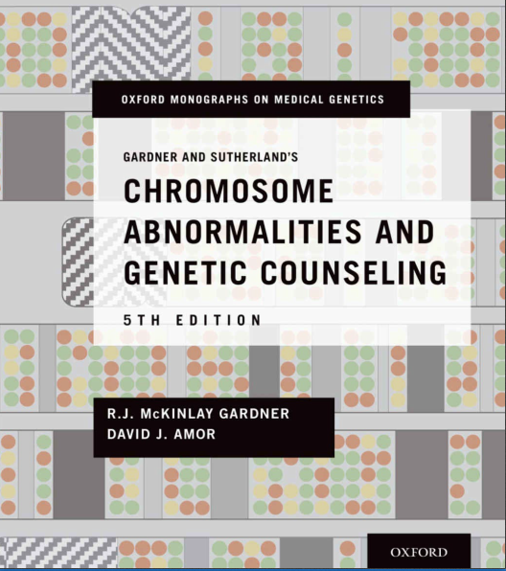

Slide 3
Outline
PART ONE: BASIC CONCEPTS
2. Chromosome Analysis
INTRODUCTION
CLASSICAL CYTOGENETIC ANALYSIS
MICROARRAY ANALYSIS
GENETIC COUNSELING CONSIDERATIONS

Slide 4
01 INTRODUCTION

Slide 5
INTRODUCTION: Clinical cytogenetics
The first
Half-century
This century
Microscopy
Molecular methodologies
Modern cytogenomic reports
sophisticated documents

Slide 6
02 CLASSICAL CYTOGENETIC ANALYSIS

Slide 7
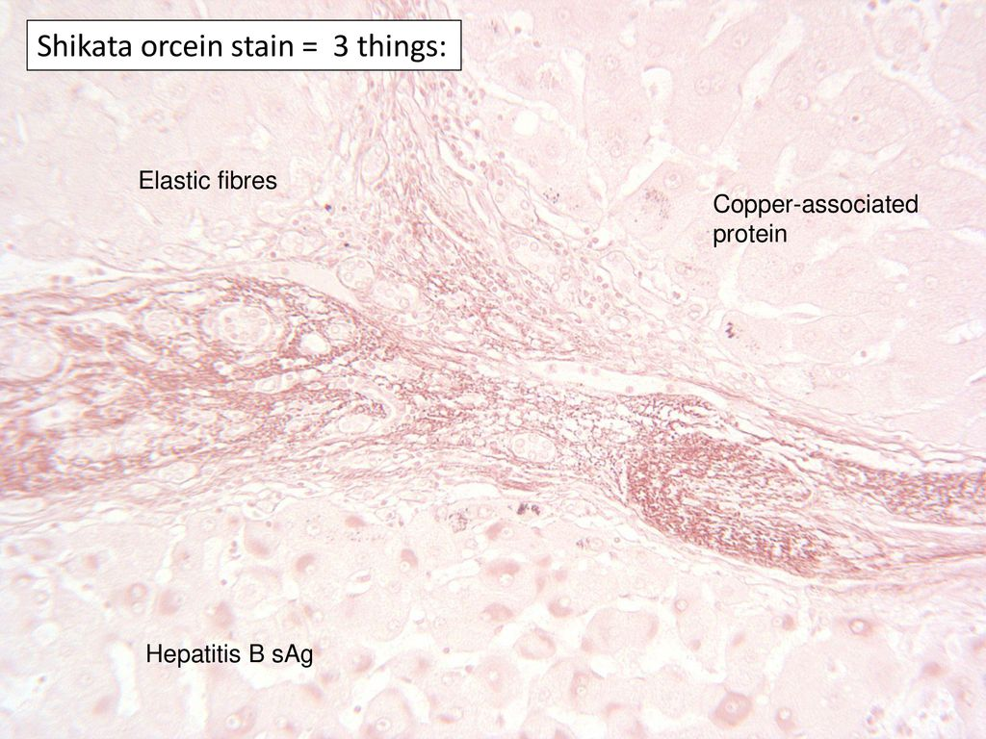
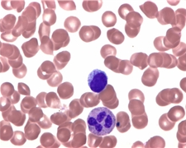
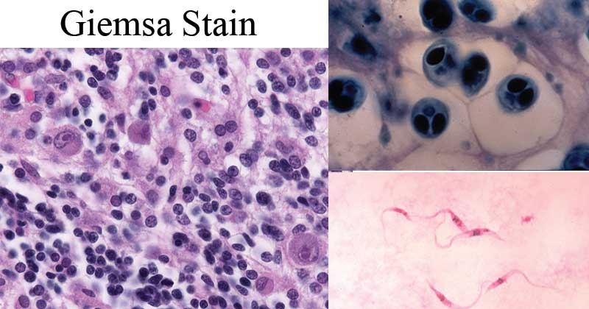
CLASSICAL CYTOGENETIC ANALYSIS
Plain staining (“solid staining”)
Early 1970s: the only stains available
Giemsa, orcein, and Leishman

Slide 8
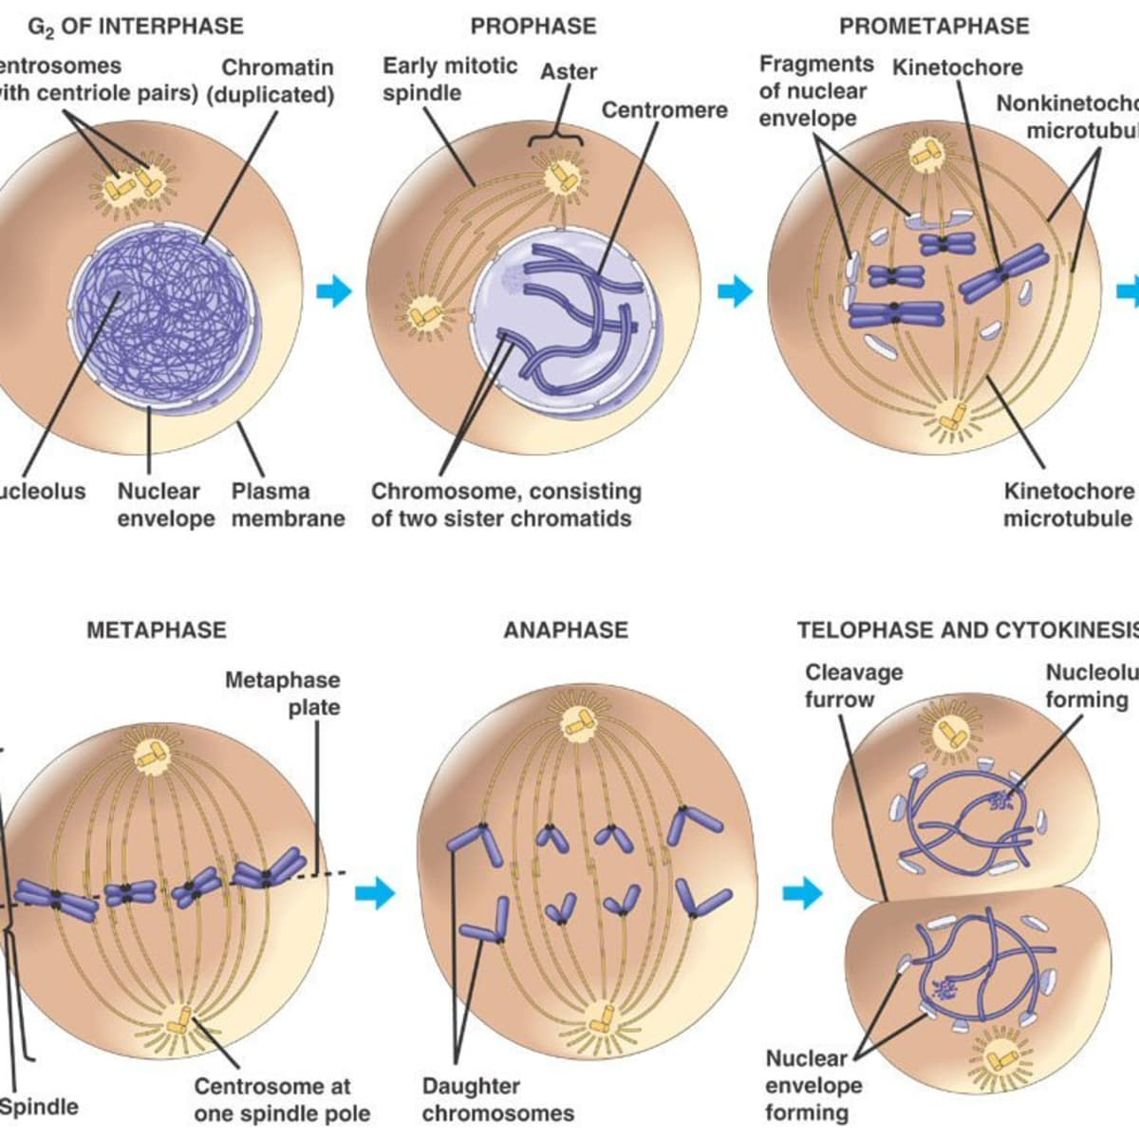
CLASSICAL CYTOGENETIC ANALYSIS
Giemsa or G-banding
Main staining method: routine classical cytogenetics
Trypsin (protein digestion) step
The detection and delineation of chromosomal structural abnormalities
Arrest the chromosome in its more elongated state
at early metaphase or prometaphase
Notes:
將染色體進行溫和的trypsin分解後用Giemsa染劑染色，染出的深色線條為G-banding。深色區為富含AT的區域。
傳統染色體分析(G-banding)可偵測染色體數量及結構上的異常，然受限於光學顯微鏡的解析度，低於5Mb 以下的染色體細微變化就無法檢出，
屬於第二代的染色體分析技術。

Slide 9
CLASSICAL CYTOGENETIC ANALYSIS
Giemsa or G-banding
Main staining method: routine classical cytogenetics
Trypsin (protein digestion) step
The detection and delineation of chromosomal structural abnormalities
Arrest the chromosome in its more elongated state
at early metaphase or prometaphase
The same morphology are quinacrine or Q-banding,
and reverse or R-banding
Notes:
將染色體進行溫和的trypsin分解後用Giemsa染劑染色，染出的深色線條為G-banding。深色區為富含AT的區域。
傳統染色體分析(G-banding)可偵測染色體數量及結構上的異常，然受限於光學顯微鏡的解析度，低於5Mb 以下的染色體細微變化就無法檢出，
屬於第二代的染色體分析技術。

Slide 10
CLASSICAL CYTOGENETIC ANALYSIS
Giemsa or G-banding
The same morphology are quinacrine or Q-banding,
and reverse or R-banding
FIGURE 2–1 Chromosome pairs 1, 6, 15, 16, and Y and X
stained by varioustechniques
Notes:
將染色體進行溫和的trypsin分解後用Giemsa染劑染色，染出的深色線條為G-banding。深色區為富含AT的區域。
傳統染色體分析(G-banding)可偵測染色體數量及結構上的異常，然受限於光學顯微鏡的解析度，低於5Mb 以下的染色體細微變化就無法檢出，
屬於第二代的染色體分析技術。
R-banding 是G-banding的相反線條型，其染色的方法為在Giemsa染色前，染色體先在生理食鹽水中加熱變性，是染富含GC的區域。

Slide 11
CLASSICAL CYTOGENETIC ANALYSIS
Constitutive or C-banding
Constitutive heterochromatin: mainly the centromeric heterochromatin
the short arms of the acrocentric chromosomes
the distal part of the long arm of the Y chromosome
FIGURE 2–1 Chromosome pairs 1, 6, 15, 16, and Y and X
stained by varioustechniques
Notes:
Constitutive heterochromatin, by definition, has no direct phenotypic effect and, in general, is devoid of active genes.

Slide 13
CLASSICAL CYTOGENETIC ANALYSIS
Replication banding
Identify inactive X chromatin
Add a nucleotide analog (BrdU):
Distinction of chromatin that replicates early from late
A banding pattern similar to that of R-banding
FIGURE 2–1 Chromosome pairs 1, 6, 15, 16, and Y and X
stained by varioustechniques
Notes:
Constitutive heterochromatin, by definition, has no direct phenotypic effect and, in general, is devoid of active genes.

Slide 14
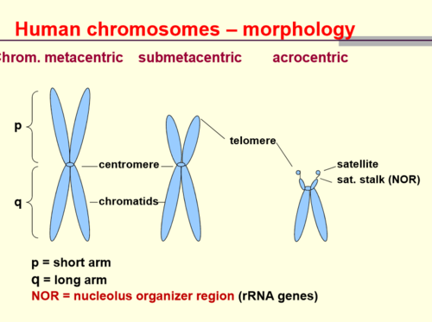
CLASSICAL CYTOGENETIC ANALYSIS
NOR (silver) staining
Nucleolar organizing regions (NOR)
Multiple copies of genes coding for rRNA
Sited on the satellite stalks of the acrocentric chromosomes
FIGURE 2–1 Chromosome pairs 1, 6, 15, 16, and Y and X
stained by varioustechniques

Slide 15
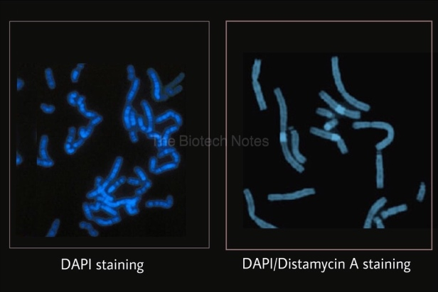
CLASSICAL CYTOGENETIC ANALYSIS
Distamycin A/DAPI staining
Fluorescent stain:
Identified heterochromatin of chromosomes 1, 9, 15, 16, and Y
Inverted duplication 15 chromosome ↔ other small marker chromosomes
https://thebiotechnotes.files.wordpress.com/2019/04/ezy-watermark_26-04-2019_03-50-58pm.jpg?w=616&h=413

Slide 16
CLASSICAL CYTOGENETIC ANALYSIS
Fluorescence in situ hybridization (FISH)
1990s: major cytogenetic advance
Identify specific chromosomes, and parts of chromosomes
→ in situ hybridization with labeled probes
Widely used: detect submicroscopic deletions and more obvious chromosome anomalies
Hybridization method
Direct: attachment of a detectable molecule (e.g. a fluorophore)
Indirect: the probe with a hapten detectable
(biotin–avidin and digoxigenin systems)
Assessment of the structural nature of imbalances revealed by
microarray analysis

Slide 17
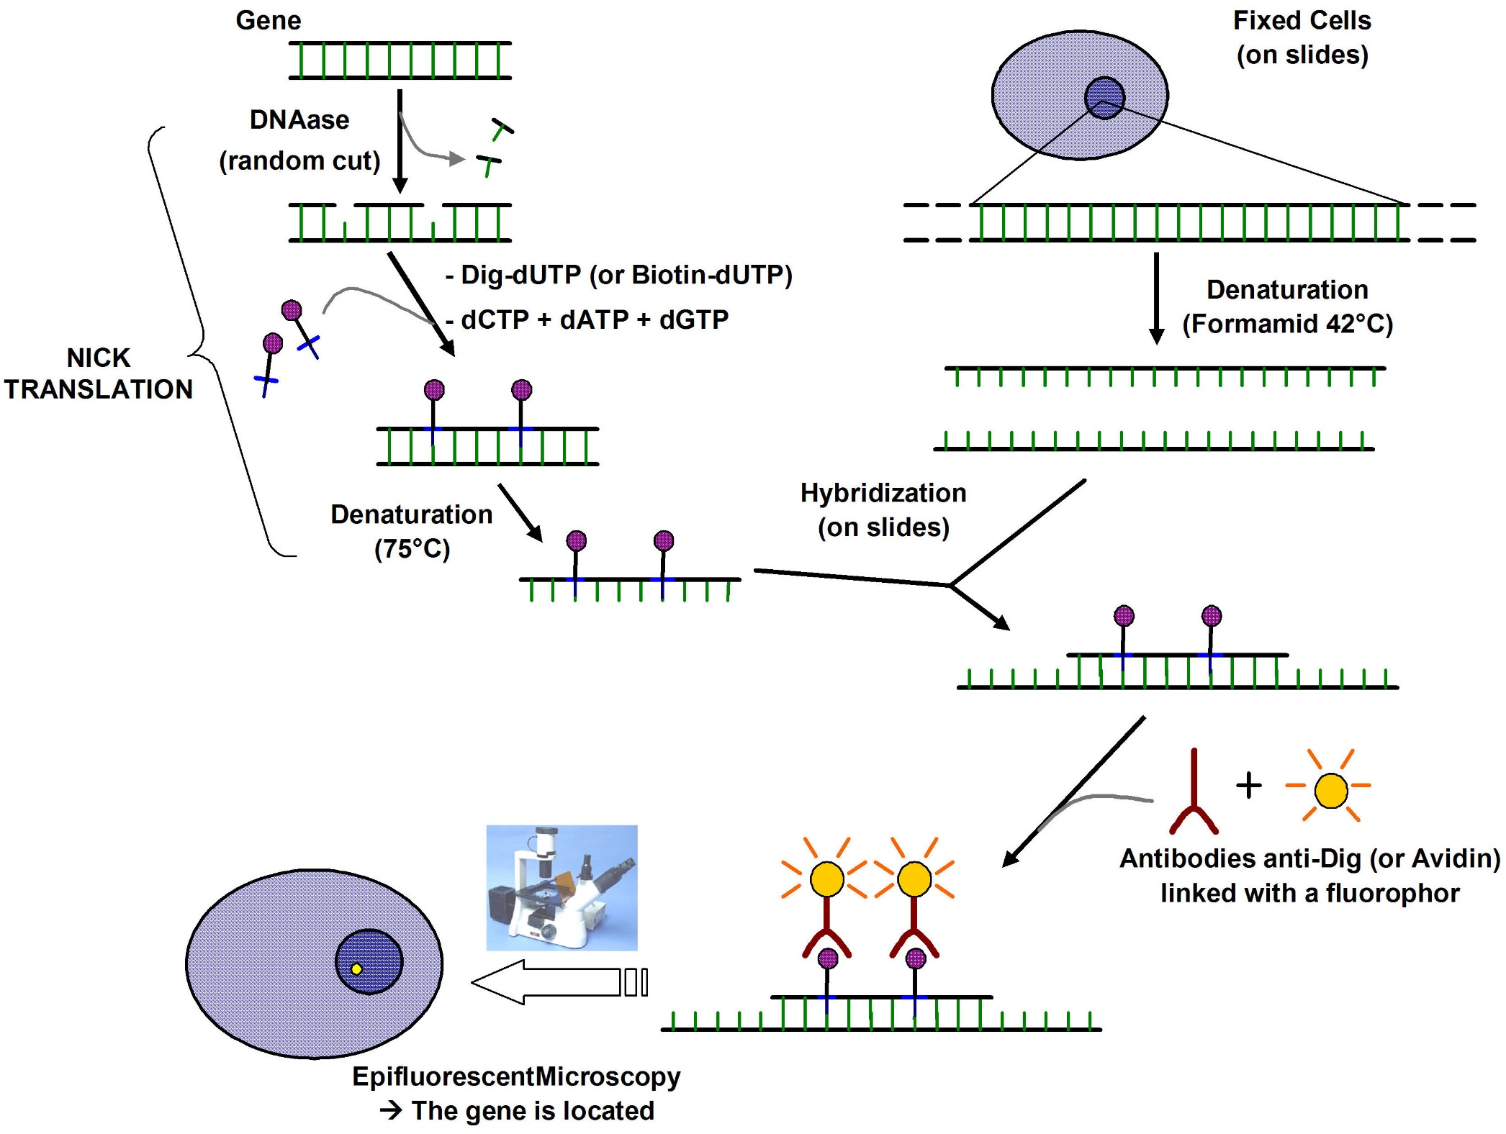
Notes:
在小片段的DNA探針上以缺口轉化法（nick translation）標定Dig-dUTP或Biotin-dUTP，接著取一片經由福馬林（formalin）固定好的組織切片，將帶有標定的單股DNA探針與之進行雜合，完成之後使用螢光標定的Anti-Dig/Biotin抗體（antibodies linked with a fluorophor）進行檢測。此抗體會專一性結合上樣本中已經被Dig/Biotin標記引子雜合的核酸，螢光標定的抗體可在螢光顯微鏡下被觀測到螢光。

Slide 18
CLASSICAL CYTOGENETIC ANALYSIS
Comparative genomic hybridization (CGH)
Differentially labeled, fluorophore-tagged DNA from the patient and a normal control
A metaphase slide prepared from a “standard” normal person
Relative excesses and deficiencies of patient DNA bind competitively
Small imbalances may be identifiable by this approach, ~10 Mb or greater
Notes:
CGH的原理係使用正常細胞與待測細胞的基因體 DNA，分別標定兩種不同顏色的螢光染劑後，同時與固定於玻璃片上的正常細胞中期染色體(metaphase chromosome)作競爭性雜合反應，再以一般螢光顯微鏡觀察讀取訊號，觀察那些特定位置的DNA有增加（gain）或減少（deletion）然而CGH受限於模板(template)染色體太大與光學顯微鏡解像力(只能到0.2 um)之限緣故，只能偵測到10個百萬鹼基(Mb)大小的基因體變化

Slide 19
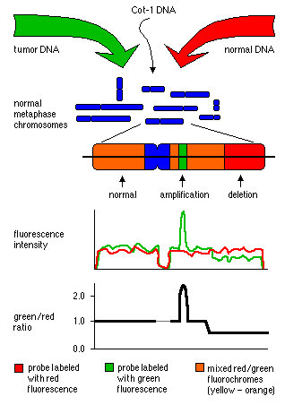
https://www.wikilectures.eu/images/3/34/CGH.gif
Notes:
CGH的原理係使用正常細胞與待測細胞的基因體 DNA，分別標定兩種不同顏色的螢光染劑後，同時與固定於玻璃片上的正常細胞中期染色體(metaphase chromosome)作競爭性雜合反應，再以一般螢光顯微鏡觀察讀取訊號，觀察那些特定位置的DNA有增加（gain）或減少（deletion）
然而CGH受限於模板(template)染色體太大與光學顯微鏡解像力(只能到0.2 um)之限緣故，只能偵測到10個百萬鹼基(Mb)大小的基因體變化。因此，有些研究學者提出以微陣列晶片來分析的概念( Solinas-Toldo et al, 1997)，將基因體DNA片段有順序的排列在玻璃片或尼龍膜上，來取代傳統的細胞中期染色體為模板，這便是以微陣列為基礎的比較性基因體雜合技術(Microarray-based comparative genome hybridization)。

Slide 20
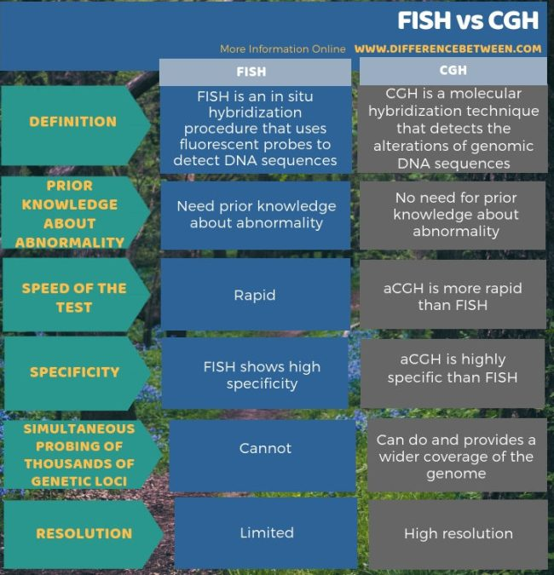

Slide 21
Disadvantages of CGH
Inaccuracies in certain regions of chromosomes
(in regions with high amounts of repeat sequences, centromeric regions of acrocentric chromosomes, in the telomeres of most chromosomes)
Copy number changes can only be spotted if more than 50% of cells analysed contain a chromosomal gain or loss
Not been able to identify chromosomal abnormalities that are balanced
Decreased sensitivity due to contamination of the test cells with normal cells

Slide 23
03 MICROARRAY ANALYSIS

Slide 24
MICROARRAY ANALYSIS
2010s:
Microarray has become the first-tier clinical diagnostic test
Developmental disabilities or congenital anomalies
Microarray techniques in use:
CGH approach
Single nucleotide polymorphisms (SNP): the number of alleles

Slide 25
MICROARRAY ANALYSIS
2010s:
Microarray has become the first-tier clinical diagnostic test
Developmental disabilities or congenital anomalies
Microarray techniques in use:
CGH approach
Single nucleotide polymorphisms (SNP): the number of alleles
most microarrays comprise thousands of spots of reference DNA sequences
Notes:
Some commercial microarrays combine CGH and SNP detection on the same array.

Slide 26
MICROARRAY ANALYSIS
Not that classical cytogenetics is likely to fade altogether from view:
Not all array results can give a definitive construction
The array cannot detect balanced rearrangements, and recognition of the carrier state will continue to need an old-fashioned chromosome test.
The molecular cytogeneticist/cytogenomicist will not lose the intuitive understanding of what chromosomes are really like.

Slide 27
MICROARRAY ANALYSIS
Balanced Chromosomal Rearrangements
All of the genetic information is present in the correct amount
But it is in the wrong location or in a different order

Slide 28
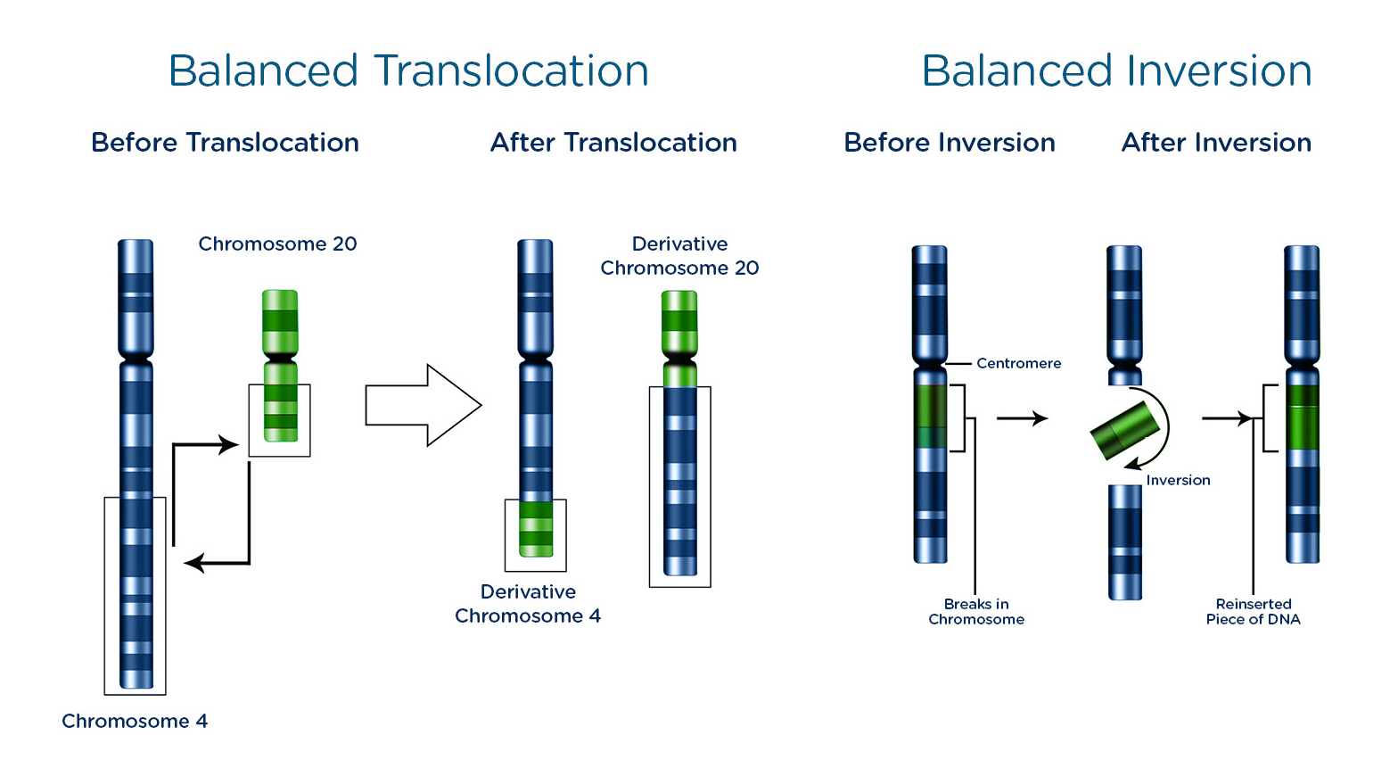
MICROARRAY ANALYSIS
Balanced Chromosomal Rearrangements
All of the genetic information is present in the correct amount
But it is in the wrong location or in a different order
http://viafet.ae/media/files/balanced_inversions_translocation_viafet.jpg

Slide 29
MICROARRAY ANALYSIS
Comparative Genomic Hybridization
The fundamental principle is essentially the same as in chromosomal CGH, but using the array, rather than the metaphase spread, as substrate.
The fluorescent intensities of each dye are measured
Excess at a locus(duplication or aneuploidy)
→ more reflect the dye of the patient’s DNA
Deficiency at a locus(deletion or unbalanced translocation)
→ more reflect the dye of the control DNA
The fluorescent intensities are presented as a log ratio of each of the dyes

Slide 30
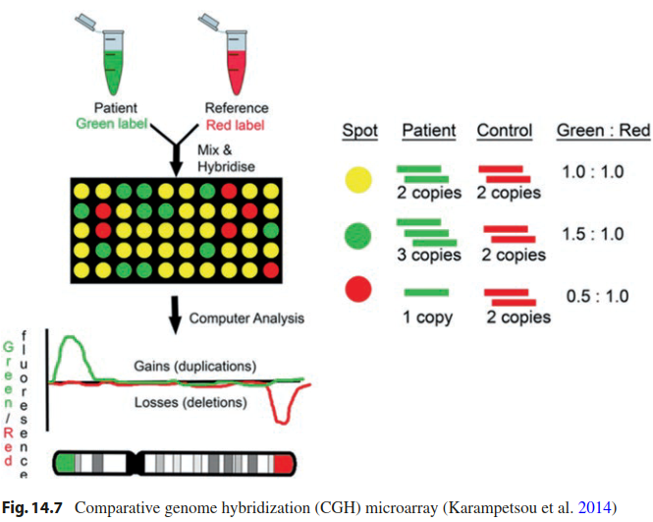
https://www.wikilectures.eu/images/3/34/CGH.gif
Notes:
然而CGH受限於模板(template)染色體太大與光學顯微鏡解像力(只能到0.2 um)之限緣故，只能偵測到10個百萬鹼基(Mb)大小的基因體變化。因此，有些研究學者提出以微陣列晶片來分析的概念( Solinas-Toldo et al, 1997)，將基因體DNA片段有順序的排列在玻璃片或尼龍膜上，來取代傳統的細胞中期染色體為模板，這便是以微陣列為基礎的比較性基因體雜合技術(Microarray-based comparative genome hybridization)。
其優點包括：可將偵測的靈敏度提高至數百個千鹼基(Kb)大小、不必繁瑣地製備染色體模板、自動化的微陣列晶片製程可大大縮短實驗時間、對於有套數變化的區域可直接找出所在基因的序列資訊、與提昇實驗的準確性。

Slide 32
MICROARRAY ANALYSIS
Comparative Genomic Hybridization
Construction of Microarray-based CGH
Bacterial artificial chromosomes (BACs) or oligonucleotides
An array with 3,000 BAC spots could detect
unbalanced rearrangements at a 1 Mb resolution across the entire genome
A study from Finland
Approximately 20% of 150 patients with mental retardation
whose G-banded karyotypes → normal
Microarray → A presumed pathogenic imbalance
Siggberg L, Ala-Mello S, Jaakkola E, et al. Array CGH in molecular diagnosis of
mental retardation—A study of 150 Finnish patients. Am J Med Genet 152A:
1398–1410, 2010.
Notes:
然而CGH受限於模板(template)染色體太大與光學顯微鏡解像力(只能到0.2 um)之限緣故，只能偵測到10個百萬鹼基(Mb)大小的基因體變化。因此，有些研究學者提出以微陣列晶片來分析的概念( Solinas-Toldo et al, 1997)，將基因體DNA片段有順序的排列在玻璃片或尼龍膜上，來取代傳統的細胞中期染色體為模板，這便是以微陣列為基礎的比較性基因體雜合技術(Microarray-based comparative genome hybridization)。
其優點包括：可將偵測的靈敏度提高至數百個千鹼基(Kb)大小、不必繁瑣地製備染色體模板、自動化的微陣列晶片製程可大大縮短實驗時間、對於有套數變化的區域可直接找出所在基因的序列資訊、與提昇實驗的準確性。

Slide 33
MICROARRAY ANALYSIS
Comparative Genomic Hybridization
Characteristics of Microarray-based CGH
Efficiently detect copy number variations (CNVs) across the whole genome
Efficiently detect the amplifications and deletions on a specific chromosome
Cannot detect the inversions and balanced reciprocal rearrangements
Widely used to diagnose postnatal cases with developmental delay (DD), autism, and/or congenital abnormalities.

Slide 34
MICROARRAY ANALYSIS
Single Nucleotide Polymorphism (SNP)
Detect the number of alleles in a specimen
Provide two types of information
Intensity of the signal arising from each SNP → A log ratio
↑signal intensity: Copy number gain
↓signal intensity: Deletion
SNP arrays produce genotyping information
Heterozygosity
Homozygosity: a loss of DNA, such as a deletion
Three allele: a gain of DNA copy number, such as a duplication or trisomy

Slide 35
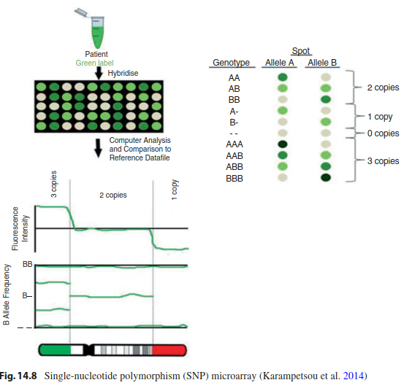

Slide 36
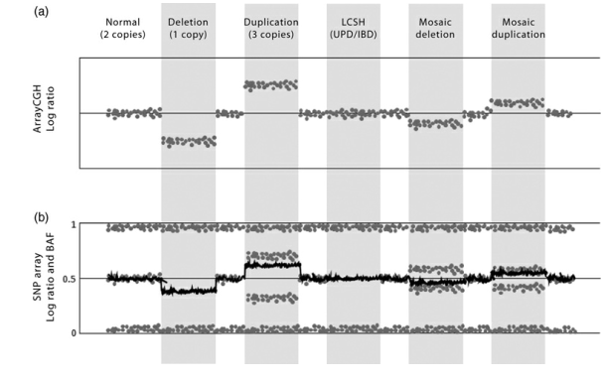
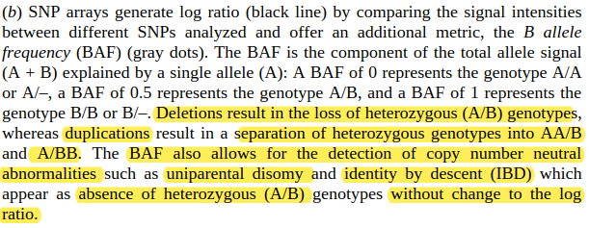

Slide 37
MICROARRAY ANALYSIS
Single Nucleotide Polymorphism (SNP)
Added advantage
Detecting uniparental disomy (UPD)
The exceptional inheritance of the two chromosomes of a pair from the same parent
Not affect number and structure of chromosomes
→ escapes cytogenetic detection
Notes:
UPD: does not affect number and structure of chromosomes. UPD therefore escapes cytogenetic detection
Uniparental isodisomy means that both chromosomes or chromosomal regions are identical (typically the result of monosomy rescue by duplication)

Slide 38
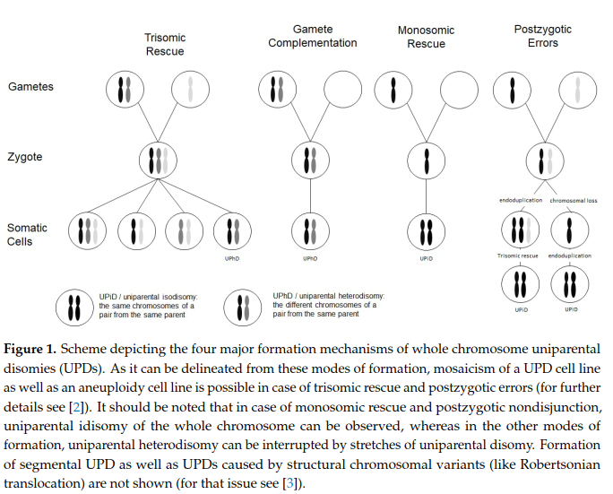
Genes 2020, 11, 1454; doi:10.3390/genes11121454

Slide 39
MICROARRAY ANALYSIS
Single Nucleotide Polymorphism (SNP)
Disadvantages
Probe spacing and genome coverage are limited by the nonrandom distribution of SNPs in the genome.
Regions of segmental duplications are usually poorly or not at all covered.

Slide 40
MICROARRAY ANALYSIS
POLYMERASE CHAIN REACTION-BASED APPLICATIONS
An efficient and cost-effective molecular tool to copy or amplify small segments of DNA or RNA
Use specific primers to amplify segments of DNA to determine copy number and identify deletions or aneuploidy
Quantitative fluorescent polymerase chain reaction (QF-PCR)
Multiplex ligation-dependent probe amplification (MLPA)

Slide 41
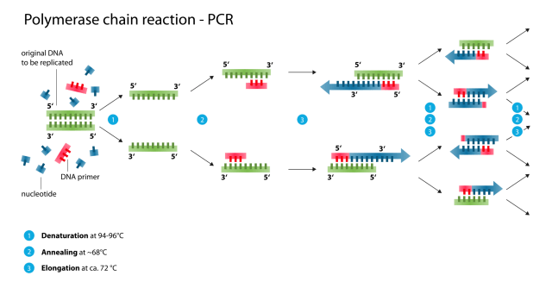

Slide 42
MICROARRAY ANALYSIS
POLYMERASE CHAIN REACTION-BASED APPLICATIONS
Applications
Identification and characterization of infectious agents
Genetic fingerprinting (forensic application/paternity testing)
Detection of mutation (investigation of genetic diseases)
Cloning genes
PCR sequencing

Slide 43
MICROARRAY ANALYSIS
NEXT-GENERATION SEQUENCING
Based on massively parallel genomic sequencing
With the entire expressed genetic complement, the “exome,” and even the whole genome
As a highly accurate molecular counting tool, sequencing cell-free DNA circulating in the maternal plasma → mapping each sequence read back to its chromosome of origin
Notes:
第一，將 DNA 打散成碎片（稱作散彈槍法）。第二，把 DNA 碎片擴增，提高序列能被偵測的濃度，基本上都是使用 PCR，但各家花樣百出（如圖一）。第三，平行定序，同時用機器大量讀取定序資料，再透過機器的演算法（同樣各有各的方法），把序列拼起來。市場上活躍的廠商有：Roche、ThermoFisher、Illumina (Solexa) 等，其中 Illumina 以後起之秀，現在幾乎囊括整個市場。

Slide 44
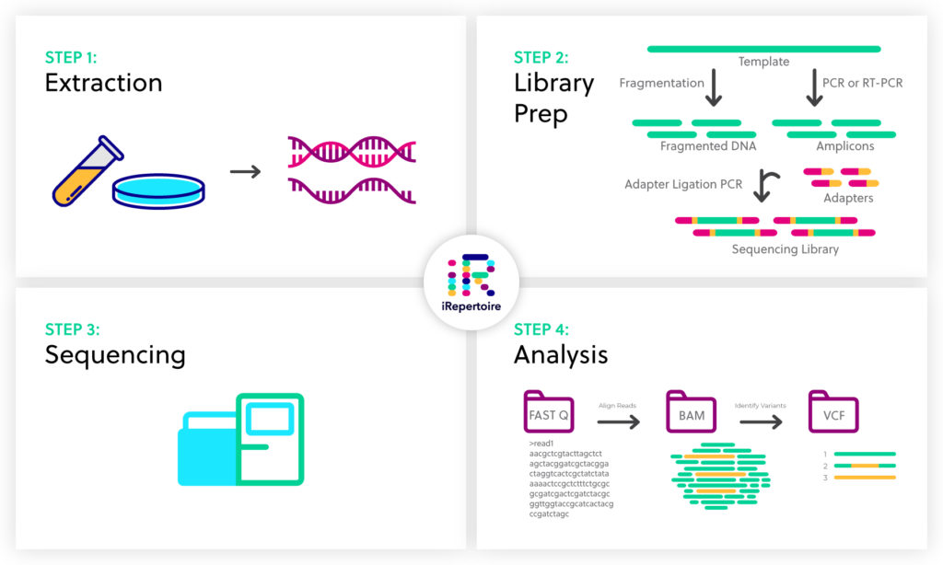
MICROARRAY ANALYSIS
NEXT-GENERATION SEQUENCING
e.g. Illumina (Solexa)
https://irepertoire.com/wp-content/uploads/2020/03/Sequencing-Workflow-1-1024x614.jpg
Notes:
Extraction: any sample that yields DNA or RNA (e.g., cell cultures, fresh-frozen tissues, formalin-fixed paraffin-embedded (FFPE) tissues, blood, saliva, and bone marrow
第一，將 DNA 打散成碎片（稱作散彈槍法）。第二，把 DNA 碎片擴增，提高序列能被偵測的濃度，基本上都是使用 PCR，但各家花樣百出（如圖一）。第三，平行定序，同時用機器大量讀取定序資料，再透過機器的演算法（同樣各有各的方法），把序列拼起來。市場上活躍的廠商有：Roche、ThermoFisher、Illumina (Solexa) 等，其中 Illumina 以後起之秀，現在幾乎囊括整個市場。

Slide 46
MICROARRAY ANALYSIS
NEXT-GENERATION SEQUENCING
Characteristics
Low-coverage genome sequencing
with 100% sensitivity, copy number variants diagnosed by microarray
The additional benefit: detecting balanced chromosome rearrangements
Higher levels of coverage
Considerable diagnostic yield
→ for the diagnosis of sequence-level mutations
Disadvantages
More expensive

Slide 47
MICROARRAY ANALYSIS
NEXT-GENERATION SEQUENCING
Coverage is variable within a sample and typical coverage ranges from 30 or less to >1000 reads for typical human genetic and cancer applications, respectively.
https://irepertoire.com/wp-content/uploads/2020/05/NGS-Considerations-Sequencing-Workflow-1024x768.png

Slide 48
MICROARRAY ANALYSIS
CYTOGENETIC (OR CYTOGENOMIC) REPORTS
Intuitive pictorial form
May also include a listing of
Presumed significant genes in the region
A comment upon imprinting
The likelihood of benign versus causative genomic changes

Slide 49
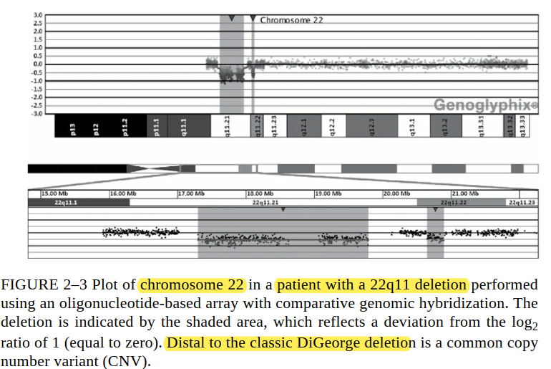
MICROARRAY ANALYSIS
CYTOGENETIC (OR CYTOGENOMIC) REPORTS
Intuitive pictorial form

Slide 50
04 GENETIC COUNSELING CONSIDERATIONS

Slide 51
GENETIC COUNSELING CONSIDERATIONS
In the majority of cases,
The abnormalities found → clear clinical relevance for the patient and family
Uncover DNA changes of unclear clinical significance
→Testing of additional family members
The possibility of findings of unclear clinical significance should be discussed when ordering the test.
molecular-based tests have the ability to interrogate the entire genome
the pretest genetic counseling should include information about uncovering unwanted information
The higher resolution potential of these new technologies will increase the detection rate of chromosome abnormalities
→ improve our ability to make diagnoses
Notes:
The use of SNP arrays may uncover substantial stretches of homozygosity due to consanguineous or even incestuous relationships

Slide 52
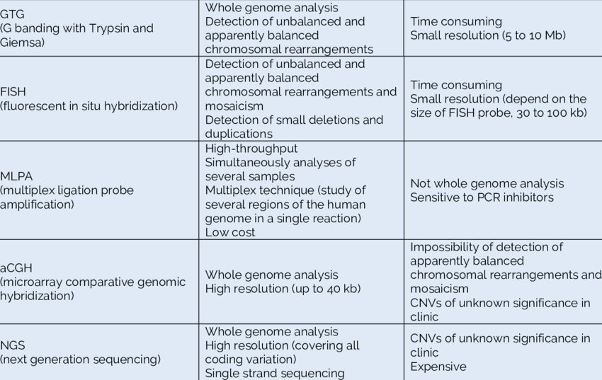
Take Home Message
Tomac, Višnja & Pušeljić, Silvija & Škrlec, Ivana & Andelic, Mirna & Kos, Martina & Wagner, Jasenka. (2017). Etiology and the Genetic Basis of Intellectual Disability in the Pediatric Population.
SEEMEDJ. 1. 144-153. 10.26332/seemedj.v1i1.28.

Slide 53
Thank You!

