Slide 1
Presenter: R2 吳孟芹
Supervisor: 張家銘 醫師
Date: 2022/10/07

Slide 2
introduction

Slide 3
Introduction
Epithelial ovarian cancer (EOC)
Most lethal gynecologic malignancy worldwide
5th leading cancer type in women in the U.S.
The poor survival is largely driven by the advanced stages (III/IV) at which EOC is diagnosed
5-year survival rate:
stage I: 90% stage II: 0–40% stage III: 15–20% stage IV: <5%
Notes:
, accounting for 5% of overall cancer-related deaths
The 5-year survival rate decreases markedly with increase in stage
majority of patients recurring, despite achieving complete remission with primary treatment

Slide 4
The current standard of care: surgical debulking + platinum-based chemotherapy
Main factors for decision making regarding duration of therapy and use of maintenance therapy:
stage, CA-125 levels, radiologic response, presence of residual disease after surgery
Maintenance strategies: systemic chemotherapy, VEGF inhibition, PARPi
Notes:
maintenance strategies systemic chemotherapy [5] and vascular endothelial growth factor (VEGF) inhibition [6]. More recently, poly (ADP-ribose) polymerase inhibitors (PARPi) have been introduced into the maintenance and treatment paradigmy
The magnitude of benefit with these strategies varies based on patient, pathologic, and molecular characteristics.

Slide 5
CA-125 levels, physical exam, and imaging remain the standard for monitoring response to treatment and detecting relapse
 | CA-125 | CT
Specificity for detection of recurrence | 91-100% lead time 2-5 months | 78-87%
Sensitivity for detection of recurrence | 56-94% | 47-75%
Clinical outcomes | Neither imaging nor CA-125 for early detection of recurrence has been found to improve clinical outcomes
Notes:
While the approach to treatment selection has evolved, tools for prognosis and prediction of treatment benefit have not
Approximately 80% of EOC will have elevated levels of CA-125 at diagnosis

Slide 6
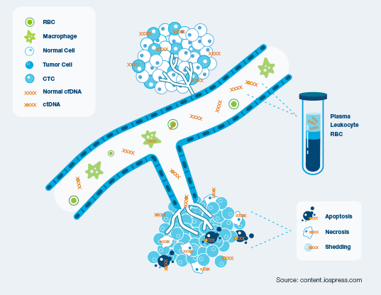
Circulating tumor DNA (ctDNA)
A non-invasive biomarker
Detect residual disease at a molecular level months ahead of radiological findings
Clinical validity of ctDNA for molecular residual disease (MRD) detection and to predict recurrence during surveillance
→ association of ctDNAbased MRD status with recurrence-free survival (RFS) and overall survival
Notes:
Approximately 80% of EOC will have elevated levels of CA-125 at diagnosis

Slide 7
methods

Slide 8
Patients: diagnosed with stage I-IV EOC
Cohort A (pre-surgery) | University of California San Francisco | Ovarian, fallopian tube, or peritoneal cancer or adnexal mass suspicious for malignancy on imaging and ultimately found to be malignant |  | plasma samples from pre-surgery
Cohort B (adjuvant setting) | Columbia University Irving Medical Center, University of Pittsburgh, and Stanford University | Ovarian, fallopian tube, or peritoneal cancers enrolled following cytoreductive surgery | followed up every 3 months for up to 40 months after the end of definitive therapy | first blood draw: 30 days after surgery
Cohort C (surveillance setting) |  | After completion of definitive treatment (surgery with/without ACT)

Slide 9
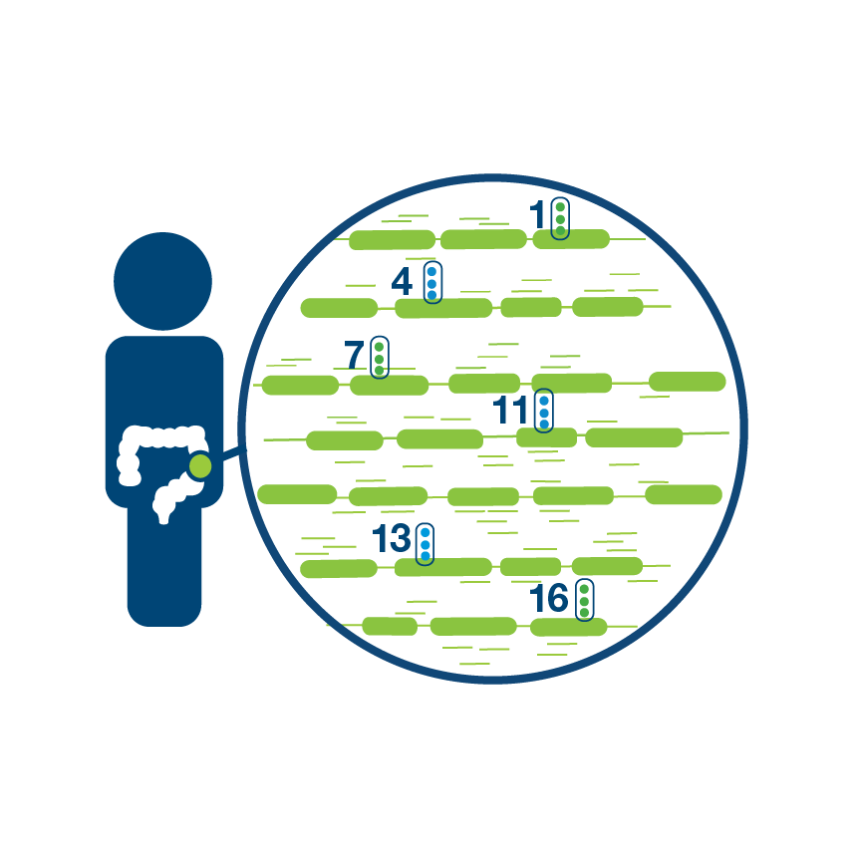
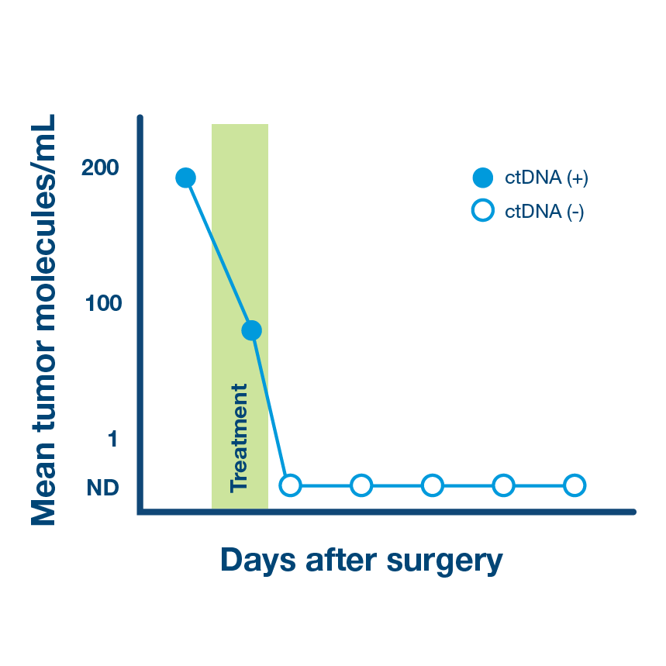
Tumor informed, personalized ctDNA assays
>
>
Sequence (WES) tumor tissue to identify unique signature of tumor mutations
Custom design and manufacture personalized mPCR assay for each patient, target the top 16 clonal mutations found in the tumor
Use personalized assay to test patient’s blood for presence of circulating tumor DNA
Notes:
1. whole exome sequencing (WES) was performed on formalin fixed paraffin embedded (FFPE) tumor blocks and matched normal DNA blood samples
2. , 2–16 patient-specific somatic clonal variants were selected for mPCR plasma testing

Slide 10
results

Slide 11
Patients characteristics

Slide 12
Patients cohort (total 69 pts)
Cohort A | 44 pts | pre-surgical plasma samples | median follow-up: 2.7 yrs
Cohort B | 12 pts | collected post-surgically and serially (every 3 months) during and after adjuvant therapy | median follow-up: 2 yrs
Cohort C | 13 pts | collected serially (every 3 months) following completion of definitive treatment (surgery with/without ACT) irrespective of maintenance therapy | median follow-up: 2 yrs

Slide 13
Genomic profiles of EOC patients
Analysis of tissue whole exome sequencing (WES) data was performed to reveal genomic profile characteristics

Slide 14
Genomic profiles of EOC patients
Notes:
. The most frequent mutations identified were in the following genes: TP53, ARID1A, KRAS, PIK3CA, EPPK1, BRCA2, BRAF, ATM, BRCA1, PTEN, and others associated with cancer pathogenesis (Fig. 1). This profile was consistent with those reported by The Cancer Genome Atlas (TCGA) consortium characteristics for EOC patients

Slide 15
Association of pre-surgical ctDNA detection with clinical features and patient outcomes (Cohort A)
Cohort A (n=44)
high-grade serous ovarian cancer | 66% (29/44)
endometrioid | 11% (5/ 44)
clear cell | 7% (3/44)
other epithelial subtypes | 16% (7/44)

Slide 16
Association of pre-surgical ctDNA detection with clinical features and patient outcomes (Cohort A)
Histology | ctDNA detection rates
Total | 73% (32/44)
high-grade serous ovarian cancer | 69% (20/29)
endometrioid | 80% (4/5)
clear cell | 100% (3/3)

Slide 17
Association of pre-surgical ctDNA detection with clinical features and patient outcomes (Cohort A)
ctDNA prevalence and levels were more elevated in high-grade disease
Higher ctDNA-positivity rates were observed in advanced-stage (Stage III/IV) vs. early-stage (Stage I/II disease) (72% vs. 60%) (p = 0.1)

Slide 18
Association of pre-surgical ctDNA detection with clinical features and patient outcomes (Cohort A)
Pre-surgical ctDNA detection rates and levels were elevated in patients who experienced disease progression and died (p = 0.026)
In the ctDNA-positive group, 43% of patients died of cancer compared to 18% in the ctDNA-negative group
n=11
n=28
Notes:
Median time to death was 2.5 years (range: 0.08–11.5).

Slide 19
ctDNA detection rates after surgical debulking and prior to adjuvant therapy (Cohort B)
Post-surgical ctDNA was detectable in 33% (4/12) of patients
75% (3/4) of patients experienced radiologic recurrence within a median time to recurrence of 19 months while only 13% (1/8) MRD-negative patients relapsed
MRDpositive patients had a higher rate of recurrence (not statistical significance)

Slide 20
ctDNA detection rates after surgical debulking and prior to adjuvant therapy (Cohort B)
Only 3 pts with plasma samples available before and after completion of ACT were MRD positive
Only one cleared ctDNA during ACT with no evidence of disease on imaging
The other two remained positive and eventually progressed

Slide 21
ctDNA detection rates following the completion of adjuvant therapy (Cohorts B and C)
22 patients from cohorts B&C had ctDNA testing following completion of primary therapy
23% (5/22) of patients had detectable ctDNA after completion of definitive therapy, all of whom experienced disease progression (p < 0.001)
Notes:
, whether surgery only or ACT (Fig. 3A, B).

Slide 22
ctDNA detection rates following the completion of adjuvant therapy (Cohorts B and C)
Inclusive of additional two patients who became ctDNA-positive during surveillance (32%; 7/22), clinical progression was ultimately confirmed by imaging (p < 0.0001)
Notes:
D, E) Kaplan-meir estimates representing the association of ctDNA status with RFS; D) at a single time point after completion of definitive treatment, E) longitudinally

Slide 23
ctDNA detection rates following the completion of adjuvant therapy (Cohorts B and C)
Longitudinally, ctDNA was detected in patients who experienced relapse with 100% sensitivity (7/7) and 100% specificity (15/15)
Notes:
D, E) Kaplan-meir estimates representing the association of ctDNA status with RFS; D) at a single time point after completion of definitive treatment, E) longitudinally

Slide 24
ctDNA, CA-125, and routine clinicopathological risk factors to predict risk of recurrence
Association of CA-125 levels post-surgery, after ACT, or longitudinally during surveillance were not prognostic in cohort B and C

Slide 25
ctDNA, CA-125, and routine clinicopathological risk factors to predict risk of recurrence
ctDNA was detectable on average 10 months (0–36 months) prior to clinical progression
CA-125 levels had a mean lead time of only ∼1 month (0–17)

Slide 26
ctDNA, CA-125, and routine clinicopathological risk factors to predict risk of recurrence
Stage and ctDNA status were independently and significantly associated with RFS (p = 0.021 and p = 0.003) and remained strong predictors in bivariate analysis
We did not observe significant association between CA-125 status or histology with RFS in this dataset
Notes:
After definitive therapy, ctDNA status was compared with CA-125, histology (clear cell vs other), and stage (III, IV vs I, II) using univariate and bivariate Cox regression analyses.

Slide 27
Discussion

Slide 28
Summary of main results
Detection of ctDNA following debulking surgery or ACT is highly prognostic
ctDNA monitoring during surveillance is feasible for early recurrence detection
Both detection and higher ctDNA levels in plasma prior to surgery was associated with higher grade histology, stage, and mortality
Notes:
, which may help identify patients at highest risk of recurrence

Slide 29
Summary of main results
ctDNA status after resection | Recurrence rate
positive | 75% (3/4)
negative | 13% (1/8)
Association was not statistically significant. Larger sample set is needed.
Presence of ctDNA during surveillance (single time point/longitudinally) is significantly associated with markedly reduced RFS

Slide 30
Summary of main results
ctDNA status after definitive therapy
A significant prognostic factor
High sensitivity and specificity for relapse prediction
Limited sample size → not able to perform a more comprehensive analysis including multiple risk factors
Further investigation is warranted
Notes:
sensitivity and specificity of ctDNA monitoring for relapse prediction were observed in all patients (100%) with longitudinal monitoring (p < 0.0001)
Further investigation is warranted and suggest that ctDNA status may add important insights to a patient's disease status and clinical outcomes

Slide 31
Summary of main results
CA-125 was inferior in predicting recurrence after definitive treatment
ctDNA detection preceded clinical relapse, on average 10 months ahead of radiological findings, compared to ∼1 month when assessed by CA-125 status
Monitoring ctDNA post-surgery and every 3 months during surveillance
→ detection of MRD with higher sensitivity than CA-125 screening and ahead of radiologic findings
Notes:
CA-125 was inferior in predicting recurrence when assessed at a single time point after definitive treatment and longitudinally

Slide 32
Results in the context of published literature
Absence of ctDNA following primary treatment was associated with improved outcomes
Poor sensitivity and specificity of CA-125 for recurrence detection → advantage of using ctDNA as a predictive biomarker for early recurrence detection
ctDNA was a potential tumor-specific biomarker for treatment response monitoring in HGSOC
Assessment of ctDNA treatment response following adjuvant therapy was prognostic
Notes:
Consistent with previously published studies across solid tumors [16–18], our findings demonstrate that the absence of ctDNA following primary treatment was associated with improved outcomes
(breast cancer metastatic recurrence , urothelial carcinoma, colorectal cancer )
Of 5 patients who were MRD-positive after ACT, all recurred (within 4 weeks = 1; < 6 months = 1; > 6 months = 3). Whereas only 2 of 17 patients who were ctDNA-negative after ACT recurred, both >12 months from last platinum therapy. These results highlight the potential utility of ctDNA analysis to monitor patient treatment response and make informed decisions about treatment efficacy ahead of radiological assessment

Slide 33
Results in the context of published literature
Majority of studies have focused on analyzing the most common somatic mutations characteristic of EOC: TP53, PTEN, PIK3CA, and BRCA1/2 genes
→ reduced sensitivity for MRD detection
Assessment of a single mutation or a static panel of variants may not accurately reflect the residual disease level
→ A personalized, tumor-informed ctDNA assay focused on the clonal variants may allow for higher precision when identifying the presence of disease at the molecular level
Notes:
We observed that exclusively targeting these and other driver variants such as BRAF and ARID1A/B (Supplementary Table 1) would have resulted in reduced sensitivity for MRD detection when analyzed longitudinally i.e., 40% vs. 100% for a tumor-informed mPCR-NGS-based ctDNA assay

Slide 34
Strengths & weaknesses
Strengths:
Prospective samples
Serially collected at scheduled intervals to demonstrate the potential of ctDNA monitoring to identify recurrence and evaluate treatment effectiveness
Limitations
Modest sample size
Heterogenous study population
Loss of follow-up for some patients

Slide 35
Implications for practice and future research
Evolution of maintenance strategies and newer therapies + MRD technologies
→ early intervention, leading to a survival advantage
Longitudinal monitoring of ctDNA in the adjuvant and surveillance settings
→ personalized disease management
→ improving survival
→ improving quality-of-life
Notes:
Historically, early recurrence detection using either second-look laparotomy or CA-125 did not result in improved survival.
Longitudinal monitoring of ctDNA in the adjuvant and surveillance settings, with a focus on MRD detection and recurrence prediction.
Evolution of maintenance strategies and newer therapies, combined with a more sensitive and specific MRD technologies, could provide an opportunity for early intervention, leading to a survival advantage
Longitudinal monitoring of ctDNA in the adjuvant and surveillance settings, with a focus on MRD detection and recurrence prediction, can aid in making timely decisions for personalized disease management, thereby improving a patient's chances of survival as well as improving their quality-of-life

Slide 36
Thank You For Listening!

