Slide 1
Autosomal Aneuploidy
Speaker : R3 胡育嘉
Supervisor: Vs 楊思婷

Slide 2
Index
Introduction
Mechanism and Etiology
Trisomy 21
Trisomy 18
Trisomy 13

Slide 3
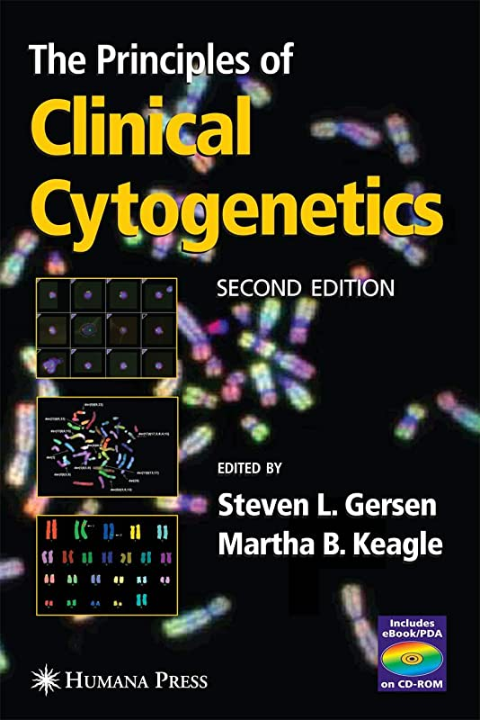
Introduction

Slide 4
Introduction
Aneuploidy: cytogenetic abnormalities in which all or part of one or more chromosomes is added(47) or deleted(45)
These can be either numerical or structural, the vast majority being trisomies, and can be present only in some cells (mosaic aneuploidy) or in all cells (nonmosaic)
Much higher incidences, approximately 27–30%, in spontaneous abortuses
Notes:
中文是非整倍體
是一種細胞遺傳學的異常，可能包含一條或是多條其中的全部或是一部分的chromosome被加入變47條或是被刪除變45條
那這也包含了數量上的異常或是結構上的異常，占最大宗的是染色體三倍體症。如果以整個人來看的話也可以分成只有部分細胞被影響到的mosaic aneuploidy或是全部細胞都被影響到的nonmosaic

Slide 5
Introduction
Cytogenetic studies of human oocytes and sperm reveal that the overall frequency of abnormalities is approximately 20% and 10%, respectively
More than 90% of the abnormalities observed in oocytes and less than 50% of those seen in sperm are numerical.

Slide 6
Introduction
The frequencies of trisomy for each chromosome might be similar at the time of conception but differ greatly among abortuses and liveborns
Many autosomal aneuploidies are lethal in the pre-embryonic stage which a particular autosomal aneuploidy correlates with the gene content of the chromosome involved

Slide 7
Introduction
Abortuses
Trisomy 16 accounts for approximately 30%
Liveborns
Chromosomes 1 and 11 have not been reported in either mosaic or nonmosaic
The majority of trisomies are 13, 18, and 21
Autosomal monosomies are extremely rare in both liveborns and recognized abortuses

Slide 8
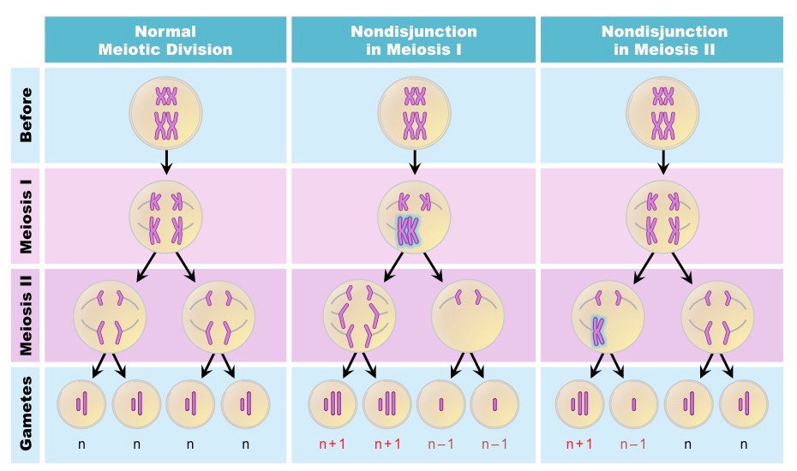
Mechanism and Etiology
Majority
Notes:
Malsegregation of homologous chromosomes 同源染色體的錯分離

Slide 9
Mechanism and Etiology
Using DNA markers, studies suggest that most trisomies are of maternal origin
A fluorescence in situ hybridization (FISH) study of human oocytes demonstrated that nondisjunction of bivalent chromosomes (MI error) does increase with maternal age
A recent study using multiplex FISH on fresh, noninseminated oocytes also indicated an increase in premature separation of the sister chromatids in MI with increasing maternal age

Slide 10
Mechanism and Etiology
It is possible that more than one mechanism contributes to the observed maternal age effect
Production line hypothesis
Limited oocyte pool hypothesis
Aberrant recombination
Notes:
Chiasmata嵌合體是屬於同源染色體的兩個染色單體之間的接觸點

Slide 11
Mechanism and Etiology
Production line hypothesis
Oocytes mature in adult life in the same order as the corresponding oogonia entered meiosis in fetal life.
Oogonia that enter meiosis later in development might be more defective in the formation of chiasmata and, thus, more likely to undergo nondisjunction.
Notes:
Chiasmata嵌合體是屬於同源染色體的兩個染色單體之間的接觸點

Slide 12
Mechanism and Etiology
Limited oocyte pool hypothesis
The number of follicles in the antral stage decreases with increasing maternal age
When the number of these follicles is low, it is more likely that an oocyte that is not at the optimal stage will be selected for ovulation
Recent data, however, do not appear to support this hypothesis
Notes:
Chiasmata嵌合體是屬於同源染色體的兩個染色單體之間的接觸點

Slide 13
Mechanism and Etiology
Aberrant recombination
Data on recombination patterns are available for trisomies 15, 16, 18 and 21
In these autosomal aneuploidy models, number of recombination events was decreased
Notes:
Chiasmata嵌合體是屬於同源染色體的兩個染色單體之間的接觸點

Slide 14
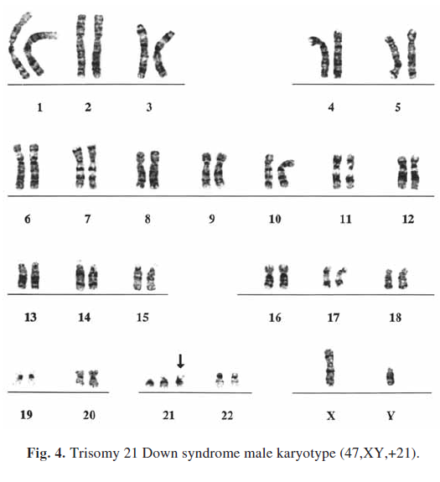
Autosomal Trisomies- Trisomy 21
Trisomy 21 was the first chromosomal abnormality described in humans
The most common single known cause of mental retardation
Males > Females(1.2:1)

Slide 15
Autosomal Trisomies- Trisomy 21
Trisomy 21: About 95% of people with Down syndrome have Trisomy 21. With this type of Down syndrome, each cell in the body has 3 separate copies of chromosome 21 instead of the usual 2 copies.

Slide 16
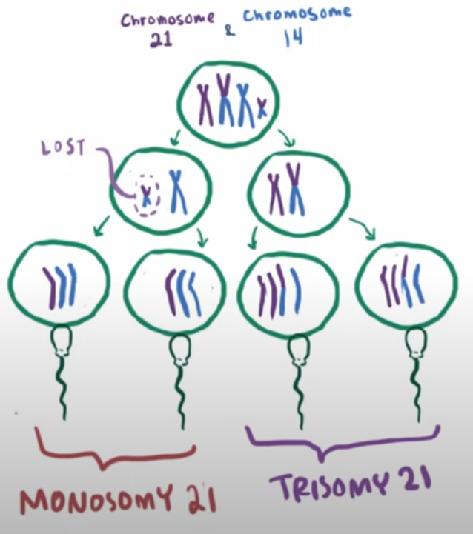
Autosomal Trisomies- Trisomy 21
Translocation Down syndrome: This type accounts for a small percentage of people with Down syndrome (about 3%). This occurs when an extra part or a whole extra chromosome 21 is present, but it is attached or “trans-located” to a different chromosome rather than being a separate chromosome 21.

Slide 17
Autosomal Trisomies- Trisomy 21
Mosaic Down syndrome: a condition in which an individual has two or more genetically distinct cell lines that originated from a single zygote
Fitzgerald and Lycette reported on a 51-year-old male who was clinically diagnosed with Down syndrome at birth, but upon cytogenetic analysis was noted to have three distinct cell lines
Practice guidelines established by the American College of Medical Genetics
Minimum of 30 metaphase spreads should be evaluated to rule out mosaicism involving sex chromosomes unless the mosaicism is detected in the analysis of the initial 20 metaphase spreads
Only allow for the exclusion of mosaicism that might be present in 8–15% of cells with 0.90–0.99% confidence
Nowadays, most lab evaluate hundreds of interphase nuclei using FISH methodology
Papavassiliou, P., Charalsawadi, C., Rafferty, K., & Jackson-Cook, C. (2015). Mosaicism for trisomy 21: a review. American journal of medical genetics. Part A, 167A(1), 26–39. https://doi.org/10.1002/ajmg.a.36861

Slide 18
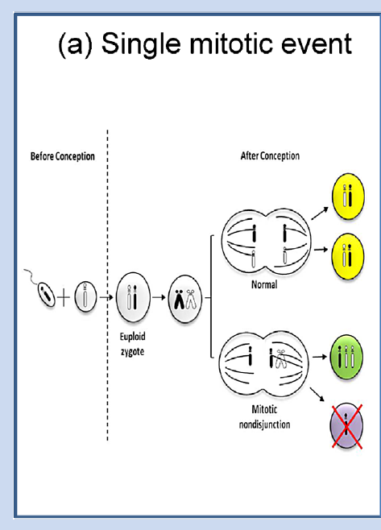
Autosomal Trisomies- Trisomy 21
Following fertilization, a euploid (normal) zygote with 46 chromosomes undergoes a mitotic nondisjunctional event, resulting in a cell with three copies of chromosome 21 (green cell)
A cell with a single copy of chromosome 21 (purple cell). It is thought that the cell with one copy of chromosome 21 would not successfully proliferative (selection to remove this cell line), while the cell with three copies of chromosome 21 would continue to proliferate and give rise to a mosaic zygote containing trisomy 21 cells (green) and normal cells (yellow)
This mechanism would result in the presence of two identical copies of one homolog in the trisomic cells.
Papavassiliou, P., Charalsawadi, C., Rafferty, K., & Jackson-Cook, C. (2015). Mosaicism for trisomy 21: a review. American journal of medical genetics. Part A, 167A(1), 26–39. https://doi.org/10.1002/ajmg.a.36861

Slide 19
Autosomal Trisomies- Trisomy 21
A zygote with three copies of chromosome 21 is formed following the merging of a normal gamete and an aneuploidy gamete (meiotic error)
Duringembryogenesis, a second, mitotic (somatic) nondisjunction event occurs to give rise to cells having two chromosomes 21 or four chromosomes 21, with the latter cells failing to successfully proliferate (selection to remove this cell line).
The cells having two copies of chromosome 21 could include either one homolog from each parent (biparental disomy; middle yellow cell), or two homologs from the same parent (uniparental disomy [UPD]; lower blue cell).
Papavassiliou, P., Charalsawadi, C., Rafferty, K., & Jackson-Cook, C. (2015). Mosaicism for trisomy 21: a review. American journal of medical genetics. Part A, 167A(1), 26–39. https://doi.org/10.1002/ajmg.a.36861

Slide 20
Autosomal Trisomies- Trisomy 21
During embryogenesis, a second, mitotic (somatic) chromosome malsegregation event occurs due to anaphase lagging (sometimes referred to as “trisomy rescue”), with the laggard chromosome potentially being excluded into a micronucleus and/or otherwise eliminated from the cell.
The resultant euploid cells would either have biparental disomy (yellow cells) or uniparental disomy (blue cells)
Papavassiliou, P., Charalsawadi, C., Rafferty, K., & Jackson-Cook, C. (2015). Mosaicism for trisomy 21: a review. American journal of medical genetics. Part A, 167A(1), 26–39. https://doi.org/10.1002/ajmg.a.36861

Slide 21
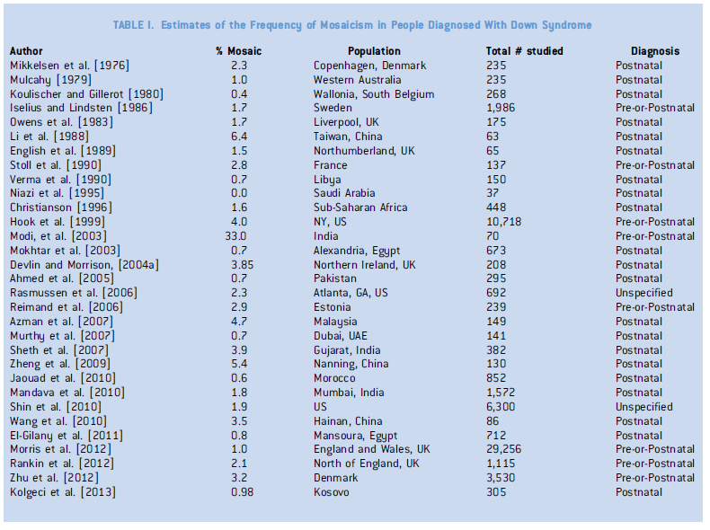
Autosomal Trisomies- Trisomy 21
The frequency of mosaicism for trisomy 21 has been estimated to range from approximately 1.3–5%of all people having some form of Down syndrome

Slide 22
Autosomal Trisomies- Trisomy 21

Slide 23
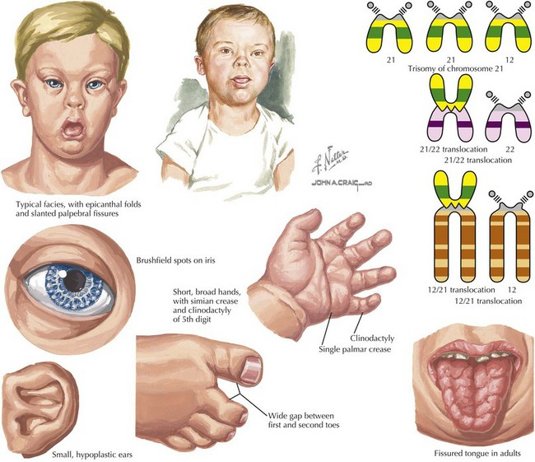
Autosomal Trisomies- Trisomy 21
Upward-slanting palpebral fissures, epicanthal folds, flat nasal bridge, small mouth, thick lips, protruding tongue, flat occiput, and small, overfolded ears.
Hands and feet are small and might demonstrate clinodactyly, hypoplasia of the midphalanx of the fifth finger, single palmar crease, and a wide space between the first and second toes.
Notes:
往上斜的眼瞼紋、雙眼皮，鼻樑扁平
小嘴厚唇，舌頭通常外露，眼窩也扁平，小耳
手腳小，有時候會看到小拇指的midphalanx比較彎曲且發育不良
斷掌

Slide 24
Autosomal Trisomies- Trisomy 21
Hypotonia and small stature are common, and mental retardation is almost invariable
Cardiac anomalies are present in 40–50% of patients, most commonly endocardial cushion defects, VSDs, PDA, ASDs
Notes:
往上斜的眼瞼紋、雙眼皮，鼻樑扁平
小嘴厚唇，舌頭通常外露，眼窩也扁平，小耳
手腳小，有時候會看到小拇指的midphalanx比較彎曲且發育不良
斷掌

Slide 25
Autosomal Trisomies- Trisomy 21
A 10- to 20-fold increase in the risk for leukemia has been observed in Down syndrome patients of all ages, with a bimodal age of onset in the newborn period and again at 3–6 years
Moreover, a transient myeloproliferative disorder (TMPD) in the newborn period, characterized by a high spontaneous remission rate with occasional relapse, occurs more frequently in children with Down syndrome.
Notes:
暫時性骨髓增生疾病

Slide 26
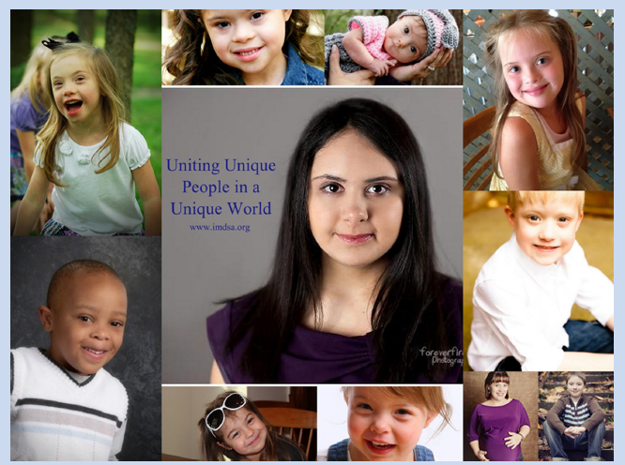
Autosomal Trisomies- Trisomy 21
Physical Traits: individuals with mosaicism who have a higher frequency of trisomy 21 cells tend to have more clinical traits
Higher risk of megakaryoblastic leukemia or transient leukemia but with good prognosis
Reduced risk for developing most types of solid tumors, with the exception of tumors derived from germ cells and potentially ovarian cancer
Notes:
往上斜的眼瞼紋、雙眼皮，鼻樑扁平
小嘴厚唇，舌頭通常外露，眼窩也扁平，小耳
手腳小，有時候會看到小拇指的midphalanx比較彎曲且發育不良
斷掌

Slide 27
Autosomal Trisomies- Trisomy 21
Overall, the clinical phenotype is typically milder in mosaic Down syndrome patients, but there is no clear correlation between the percentage of trisomy 21 cells and the severity of clinical presentation
Patients with partial trisomy 21 who present clinically with various features of the syndrome

Slide 28
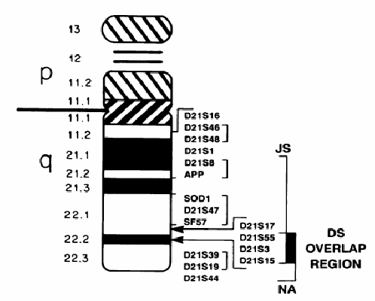
Autosomal Trisomies- Trisomy 21
Genes for CuZn–superoxide dismutase (SOD1) and amyloid precursor protein (APP), located proximal to band 21q22.1
Parts of bands 21q22.2 and 21q22.3, including locus D21S55, can be the minimal region necessary for the generation of many Down syndrome features.

Slide 29
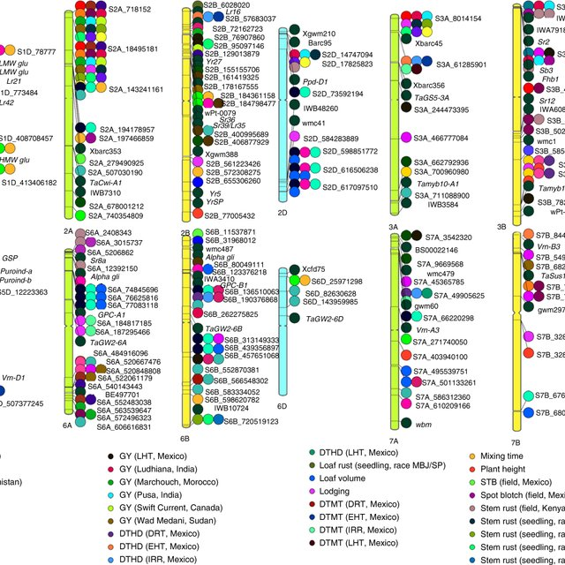
Autosomal Trisomies- Trisomy 21
Studies by Korenberg et al. suggest that many chromosome 21 regions are responsible for various Down syndrome features so they used a panel of cell lines to construct a “phenotypic map” correlating 25 Down syndrome features with regions of chromosome 21

Slide 30
Autosomal Trisomies- Trisomy 21
13 families with two trisomy 21 children showed that three had a parent who was mosaic for trisomy 21 and two had a parent who was potentially mosaic
A family with 3 trisomy 21 children, the mother was mosaic for trisomy 21 in lymphocytes and skin fibroblasts
Gonadal mosaicism in one parent is an important cause of recurrent trisomy 21 and should be looked for in families with more than one affected child
When present, the recurrence risk will be high and will depend on the proportion of trisomy 21 cells in the gonad

Slide 31
Autosomal Trisomies- Trisomy 21
In general, the recurrence risk for mosaic trisomy 21 that results from mitotic nondisjunction should not be increased.
However, several studies shown that in a relatively high proportion of cases, the mosaicism results from the loss of one chromosome 21 during an early mitotic division in a zygote with trisomy 21
In such cases, the recurrence risk for nondisjunction will be the same as for nonmosaic trisomy 21.

Slide 32
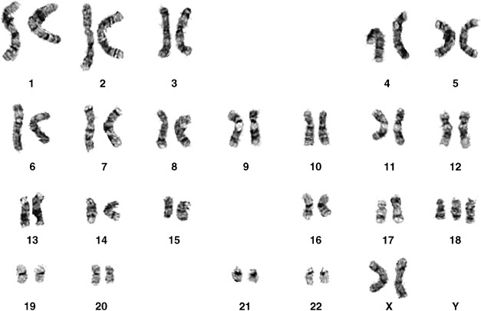
Autosomal Trisomies- Trisomy 18
Trisomy 18 [47,XX or XY,+18] was first described by Edwards et al.
The incidence is 1 in 6000–8000 births. It is more frequent in females, with a male-to-female ratio of 1 : 3–4
The risk for trisomy 18 also increases with maternal age

Slide 33
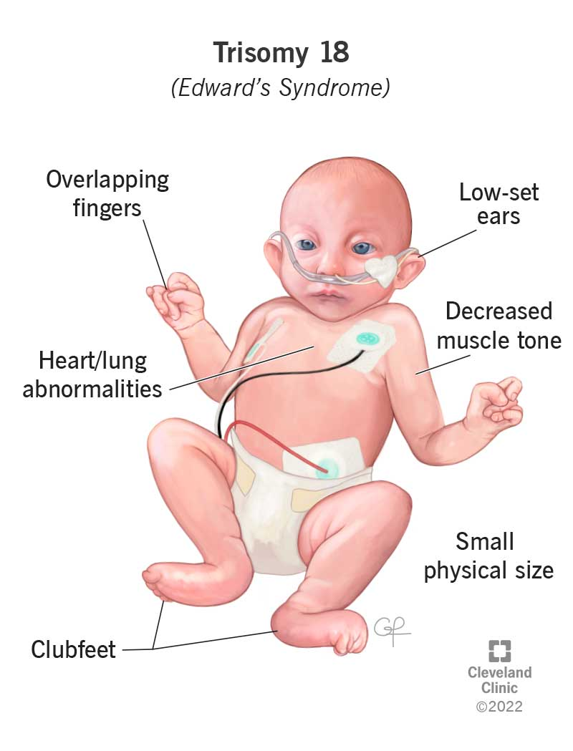
Autosomal Trisomies- Trisomy 18
Mental and growth deficiencies
Neonatal hypotonicity followed by hypertonicity
Craniofacial dysmorphism
Prominent occiput
Narrow bifrontal diameter
Short palpebral fissures
Small mouth
Narrow palate
Low-set malformed ears
Micrognathia
Notes:
隱睾症、多毛，胸骨短小

Slide 34
Autosomal Trisomies- Trisomy 18
Cardiac anomalies (mainly VSD, ASD, and PDA).
Short dorsiflexed hallux, hypoplastic nails, rocker bottom feet, short sternum, hernias, single umbilical artery, small pelvis, cryptorchidism, hirsutism
Notes:
隱睾症、多毛，胸骨短小

Slide 35
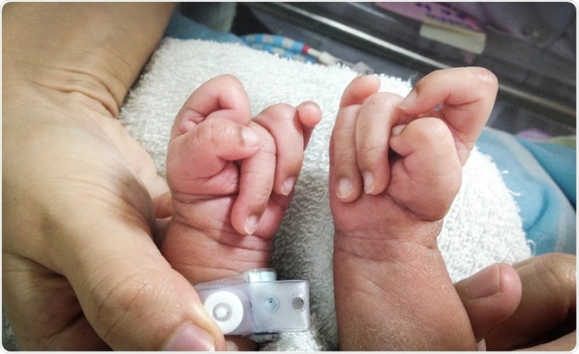
Autosomal Trisomies- Trisomy 18
Clenched hand with tendency for the second finger to overlap the third and the fifth finger to overlap the fourth

Slide 36
Autosomal Trisomies- Trisomy 18
Median survival averages : 5 days
1-week survival at 35–45%
Fewer than 10% of patients survive beyond the first year of life.
Mosaic trisomy 18 patients have milder phenotypes
Six mosaic trisomy 18 patients, all females, with normal intelligence and long-term survival have been reported

Slide 37
Autosomal Trisomies- Trisomy 18
Two recent molecular studies, suggest that the region proximal to band 18q12 does not contribute to the syndrome, whereas two critical regions, one proximal (18q12.1 → q21.2) and one distal (18q22.3 → qter), could work in cooperation to produce the typical trisomy 18 phenotype
In addition, severe mental retardation in these patients could be associated with trisomy of the region 18q12.3 → q21.1.

Slide 38
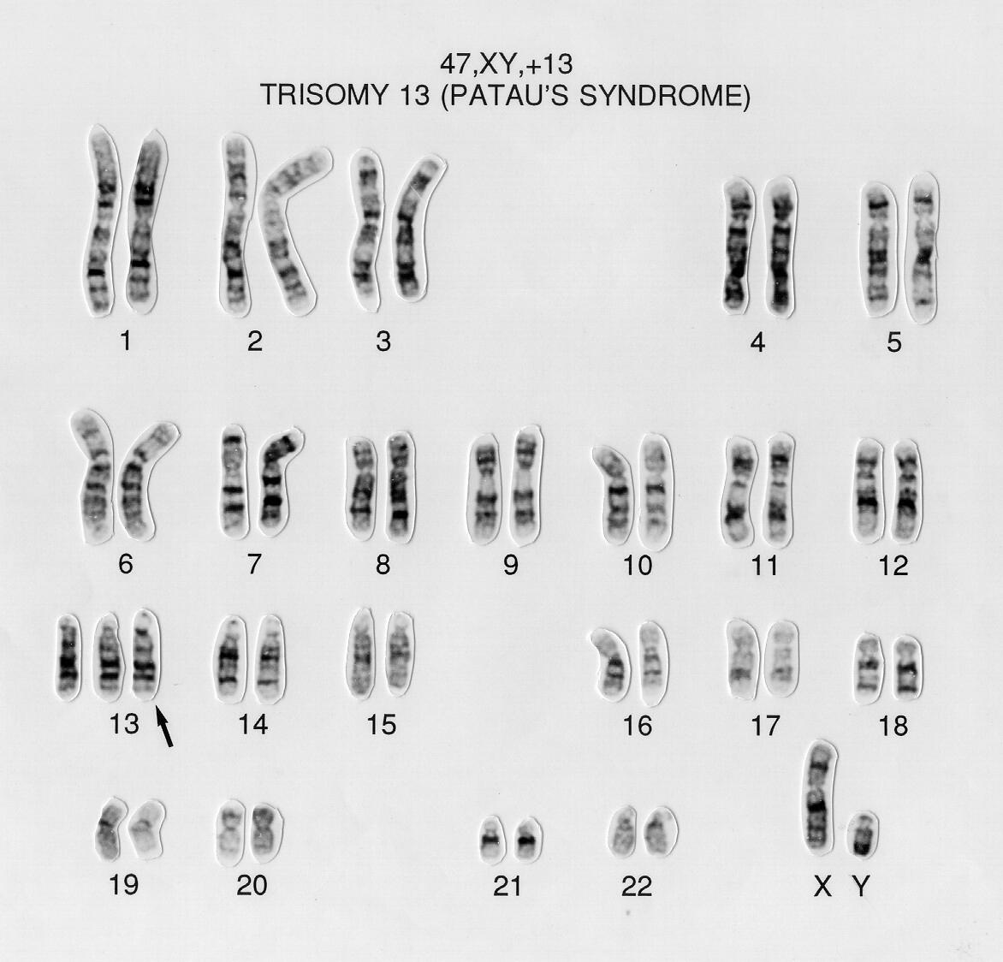
Autosomal Trisomies- Trisomy 13
Trisomy 13 [47,XX or XY,+13]
Incidence: 1 in 12,000 births
Slightly more in females
Risk increases with maternal age

Slide 39
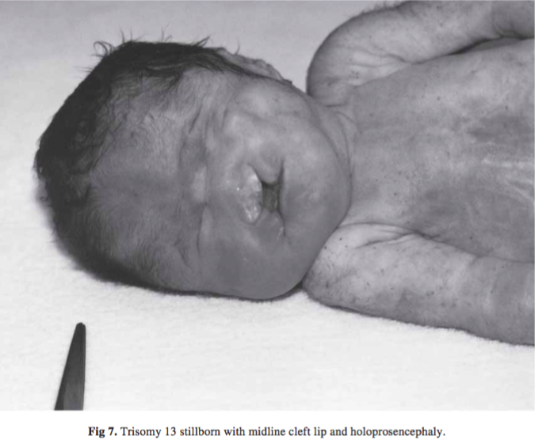
Autosomal Trisomies- Trisomy 13
Phenotype:
Holoprosencephaly spectrum
Scalp defects
Microcephaly with sloping forehead
Large fontanels
Capillary hemangioma
Microphthalmia
Cleft lip, cleft palate

Slide 40
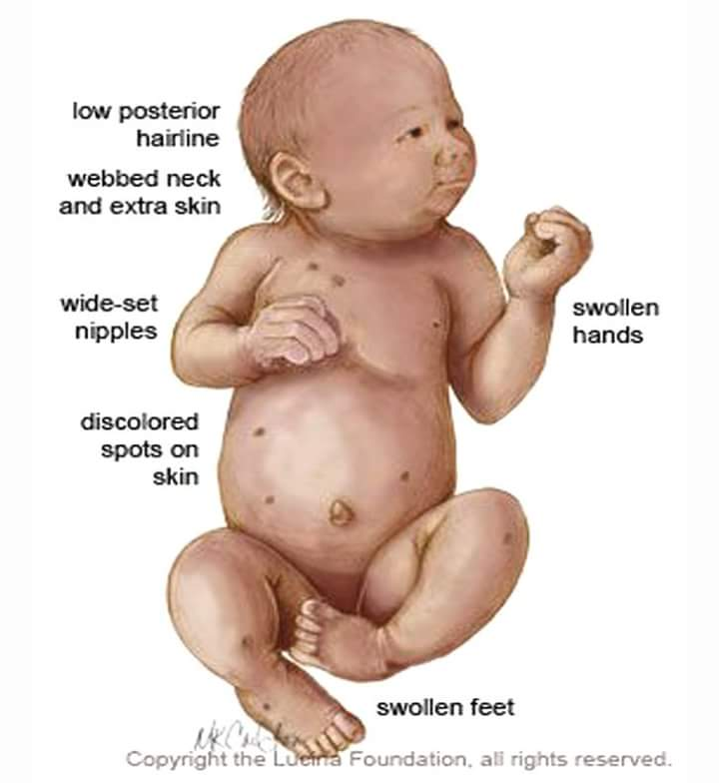
Autosomal Trisomies- Trisomy 13
Phenotype:
flexion of the fingers
polydactyly
hernias
single umbilical artery
cryptorchidism
bicornuate uterus
cardiac abnormalities(80% has VSD, PDA, and ASD)

Slide 41
Autosomal Trisomies- Trisomy 13
Prognosis is extremely poor
Median survival: 2.5 days
6-month survival: 5%
Severe mental deficiencies, failure to thrive, seizures are common
Mosaic trisomy 13 are in general less severe, but the degree varies and can be as severe as nonmosaic trisomy 13

Slide 42
Autosomal Trisomies- Trisomy 13
The proximal segment (13pter → q14) contributes little to the trisomy 13 phenotype, whereas the distal segment (all or part of 13q14 → qter) is responsible for the complete trisomy 13 features
Molecular studies for a more accurate delineation of the breakpoints have not been done

Slide 43
Autosomal Trisomies- Trisomy 13
No empirical recurrence risk data available
A less than 1% risk is generally quoted for genetic counseling purposes

Slide 44
