Slide 1
Anastrozole or letrozole for ovulation induction in clomiphene-resistant women with polycystic ovarian syndrome: a prospective randomized trial
台北榮民總醫院婦產部
暨國立陽明大學醫學系婦產科
張昇平

Slide 2
Objective: To compare the effects of letrozole ( 2.5 mg) and anastrozole (1 mg) meant for ovulation induction in clomiphene (CC)-resistant women with PCOS.
Design: Prospective randomized trial.
Intervention(s): Patients were randomized to treatment with 2.5 mg of letrozole daily (111 patients, 295 cycles) or 1 mg of anastrozole daily (109 patients, 279 cycles) for 5 days from day 3 of menses.
Main Outcome Measure(s): Number of follicles, serum E2, serum P, endometrial thickness, pregnancy rate (PR), and miscarriage rate.

Slide 3
Conclusion(s):
The results of this study did not show a significant difference in PR or miscarriage rate between anastrozole and letrozole when used for ovulation induction in women with CC-resistant PCOS. (Badaway A et al. Fertil Steril 2008;89:1209–12)

Slide 4
前言
Polycystic ovary syndrome (PCOS) is a common endocrine disorder in young women.
It manifests itself in a variety of clinical ways and 55%–75% of patients with PCOS are infertile due to chronic anovulation (Kovacs G et al. Aust NZ J Obstet Gynecol 2001;41)

Slide 5
Clomiphene resistance refers to persistence of anovulation after standard CC therapy, which occurs in 15%–20% of patients.
Clomiphene citrate may have a negative effect on the cervical mucus and endometrium and is associated with a discrepancy between ovulation and conception rate.
Alternatives to CC such as gonadotropins are used but they are expensive and increase the risk of multiple pregnancy and ovarian hyperstimulation syndrome (OHS).

Slide 6
MATERIALS AND METHODS
The study comprised of 220 women (574 cycles) with CC resistant PCOS among those attending the Fertility Outpatient Clinic in Mansoura University Hospitals, Mansoura University, Egypt, and a private practice setting in the period from May 2005 to January 2007.
All women were previously treated with 100 mg of CC daily for 5 days per cycle, for two to three cycles with persistent anovulation or ovulate with very thin endometrium <5 mm at the time of hCG administration.

Slide 7
All patients were monitored by transvaginal ultrasound for the mean follicular diameter and endometrial thickness in the days 10, 12, and 14 of the cycle.
Serum E₂ (pg/mL) was measured at the time of hCG injection by RIA using direct double antibody kits and serum P was measured on days 21–23 of the cycle.
Human chorionic gonadotropin injection (5,000–10,000 IU IM, Pregnyl; Organon, Oss, Holland) was given when one follicle measured at least 18 mm was found.
Patients were advised to have intercourse 24–36 hours after hCG injection.

Slide 8
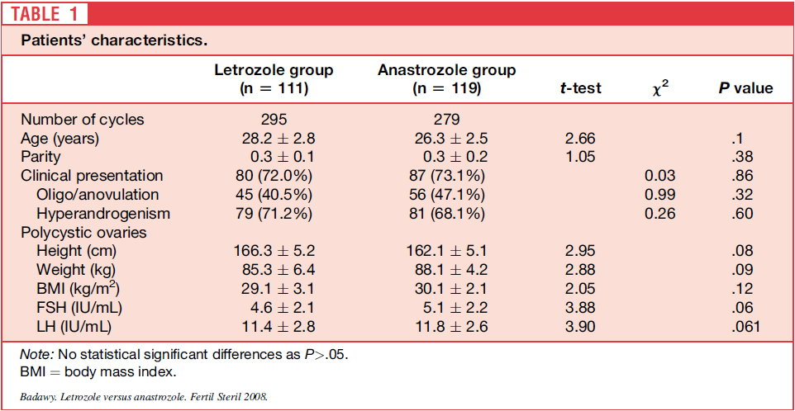
RESULTS
（n = 109）

Slide 9
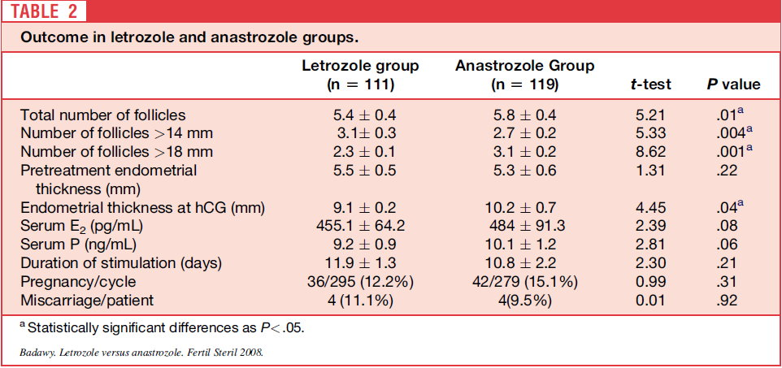
（n = 109）

Slide 10
DISCUSSION
Letrozole (4,40-[1H-1,2,4-triazol-1-ylmethylene]-bis-benzonitrile) and anastrozole (2, 20[5-(1H-1,2,4-triazol-1-ylmethyl)-1, 3-phenlene]bis(2-methylpropiononitrile)) are third generation aromatase inhibitors.
Administering aromatase inhibitors early in the follicular phase can induce ovulation by releasing the hypothalamus or pituitary from estrogen (E) negative feedback on GnRH and gonadotropin secretion, which would stimulate ovarian follicular development.

Slide 11
An alternative hypothesis is that aromatase inhibitors may act locally in the ovary to increase follicular sensitivity to FSH by accumulation of intraovarian androgens.
In addition, androgen accumulation in the follicle may stimulate insulin-like growth factor I (IGF-I), along with other endocrine and paracrine factors, which may synergize with FSH to promote folliculogenesis.

Slide 12
In a pharmacologic study of menopausal women, 1 mg of anastrozole suppressed E₂ levels to the same extent as 2.5 mg of letrozole.
Letrozole (2.5 mg) was slightly more effective in inhibiting total body aromatization during 6 weeks. (Geisler J et al. J Clin Oncol 2002)

Slide 13
This E₂ level allowed the growth of the endometrium to an adequate thickness on the day of hCG administration, showing the absence of the antiestrogenic effects seen with CC.
Cortinez et al. (Fertil Steril 2005;83) found normal morphology of the endometrium and full expression of pinopodes during the implantation window when aromatase inhibitors were used.

Slide 14
Recently, the safety of letrozole was seriously questioned.
An abstract presented at the American Society for Reproductive Medicine (ASRM) meeting in 2005, examining a relatively small number of letrozole pregnancies (130 pregnancies) compared to a large control group of spontaneous conceptions, suggested that the use of letrozole for infertility treatment might be associated with a higher risk of congenital cardiac and bone malformations in the newborns (Biljan MM et al. Fertil Steril 2005;84(Suppl 1))

Slide 15
As a result of this small study, on November 17, 2005, Novartis Pharmaceutical, the manufacturer, issued a statement to physicians in Canada and worldwide advising that letrozole use in premenopausal women, specifically its use for ovulation induction, is contraindicated.
A more recent multicenter retrospective study in Canada by Tulandi et al. (Fertil Steril 2006;85) on the pregnancy outcome after letrozole induction concluded that the concern about letrozole use for ovulation induction was unproved.

Slide 16
Results:
Overall, congenital malformations and chromosomal abnormalities were found in 14 of 514 newborns in the letrozole group (2.4%) and in 19 of 397 newborns in the CC group (4.8%).
The major malformation rate in the letrozole group was 1.2% (6/514) and in the CC group was 3.0% (12/397).

Slide 17
One newborn in the letrozole group was found to have a ventricular septal defect (0.2%) compared to 4 newborns in the CC group (1.0%).
In addition, the rate of all congenital cardiac anomalies was significantly higher (P: 0.02) in the CC group (1.8%) compared to the letrozole group (0.2%).

Slide 18
It appears that congenital cardiac anomaly is less frequent in the letrozole group.
The concern that letrozole use for ovulation induction could be teratogenic is unfounded based on our data. (Tulandi T et al. Fertil Steril 2006;85:1761–5)

Slide 19
Toxicology studies showed that anastrozole is well tolerated at 1 and 6 months.
Oral administration of anastrozole to pregnant rats and rabbits caused no teratogenic effects (Anastrozole monograph.2002).

Slide 20
In another study, Forman et al., compared 112 newborns following letrozole treatment to 271 newborns following CC treatment and 94 newborns following spontaneous pregnancy.
The rate of malformations was 0, 2.6%, and 3.2%, respectively.

Slide 21
Therefore, the concern that letrozole use for ovulation induction could be teratogenic may be unfounded based on these data. (J Obstet Gynecol Can 2007;29)
The cost of letrozole and anastrozole/cycle are comparable, but both are much more expensive than CC, especially when higher doses of letrozole/anastrozole are required.

Slide 22
Thank you for your attention !

