Slide 1
Lab study in physical medicine and rehabilitation
台北榮總復健醫學部
R4 程遠揚

Slide 2

Important Lab studies in physical medicine and rehabilitation
Nerve conduction study and electromyography
Urodynamic study
Cardiopulmonary exercise testing

Slide 3
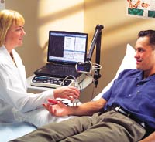
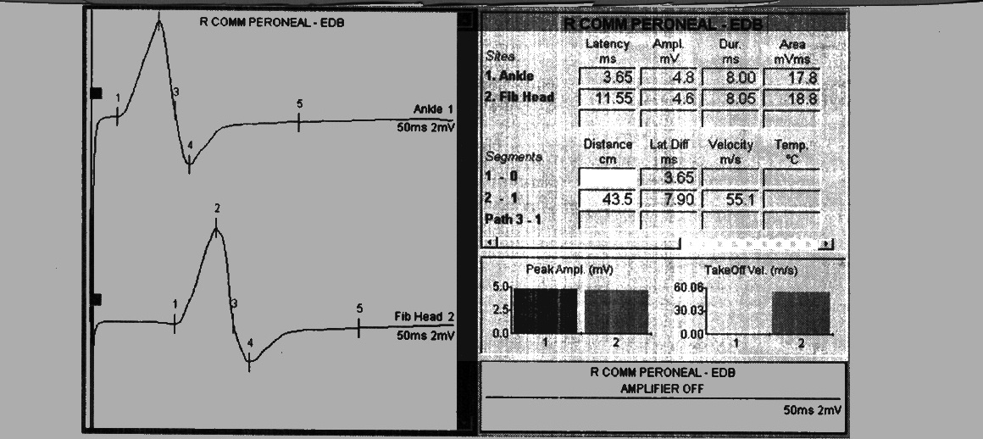
Nerve Conduction study
Tools: Stimulator, grounding electrode, reference electrode, recording electrode
Note the amplitude, duration, area, distal latency, and conduction velocity in each study

Slide 4
Nerve conduction study
Amplitude: direct correlate to the axon fiber remained. Other reasons of amplitude drop includes: myopathy, neuromuscular junction disease, conduction block, or disuse atrophy
Conduction velocity: correlate to the integrity of nerve myelin. CMAP velocity is calculated by both distal and proximal stimulation. SNAP velocity is calculated directly by distal stimulation.

Slide 5
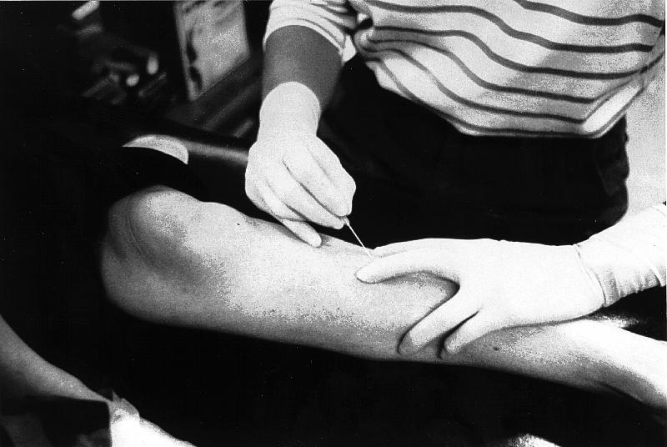
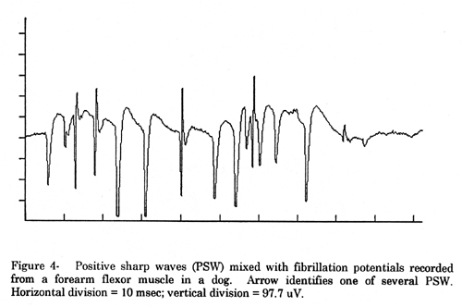
Electromyography
Resting: observe if spontaneous activity including positive sharp wave or fibrillation presents
Minimal contraction: Observe each MUAP’s morphology, amplitude, and duration.
Assess the recruitment pattern

Slide 6
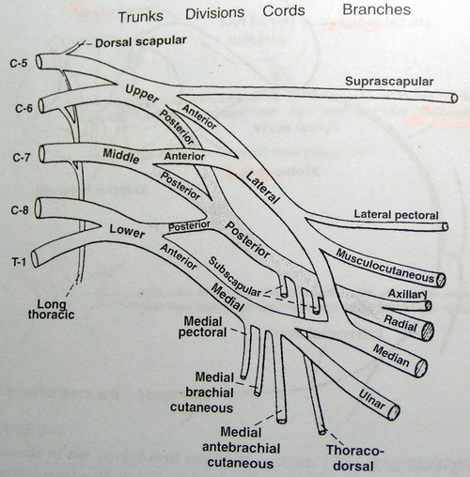
Purpose for NCS/EMG
Determine the type of neuromuscular disease
Determine the lesion level
Determine the timing of the lesion
Determine the severity of the lesion

Slide 7
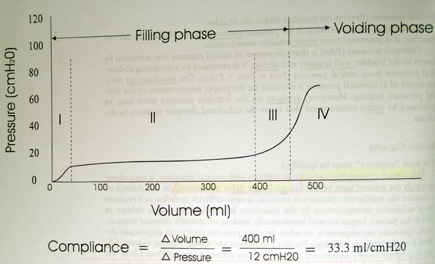
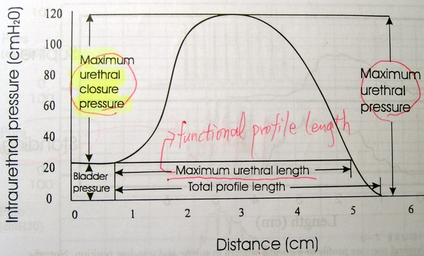
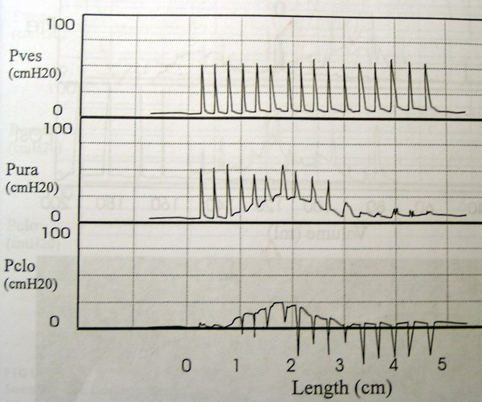
Urodynamic study
Cystometry
Sphincter electromyography
Uroflometry
Urethral pressure profile

Slide 8
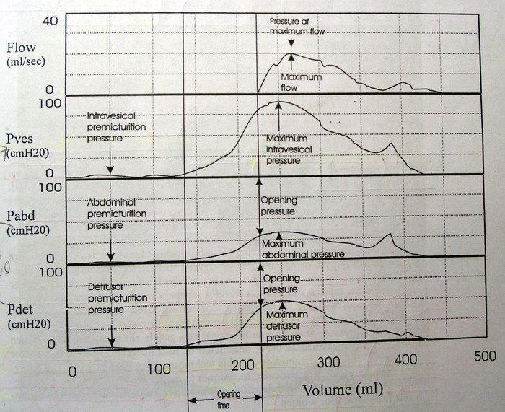
Urodynamic study

Slide 9
Purpose for urodynamic study
Evaluation the type of neurogenic bladder after CNS injury
Uninhibited bladder
Spastic bladder
Flaccid bladder
Determine the severity of stress urinary incontinence
Determine the presence and severity of benign prostate hyperplasia

Slide 10
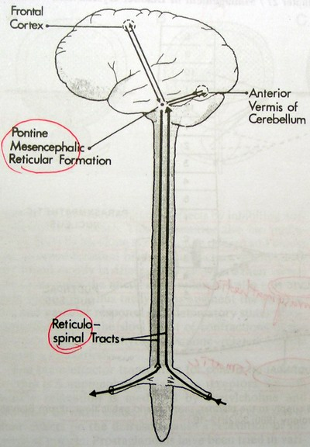
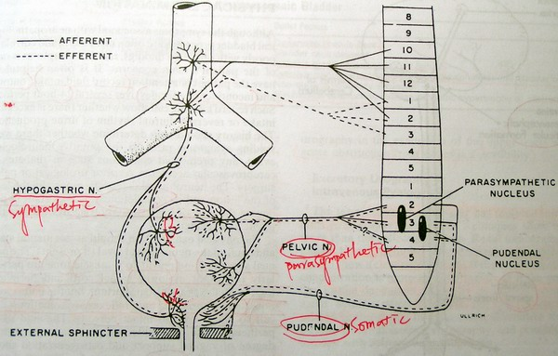

Slide 11
Cardiopulmonary exercise testing
Evaluate the change of blood pressure, heart rate, and ventilation during graded exercise testing with increasing intensity
Determine the anaerobic threshold by plotting of exercise testing
Observe the peak exercise response. Determine the maximum oxygen consumption of the patient.

Slide 12
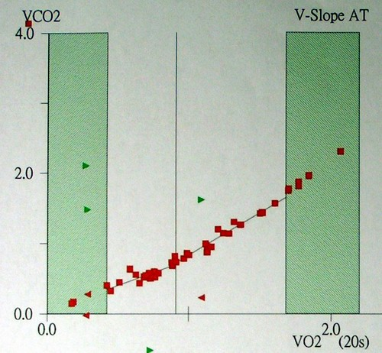
V-slope method for anaerobic threshold

Slide 13
Purposes for cardiopulmonary exercise testing
For reference of exercise program prescription
To evaluate the severity of cardiovascular disease and make suggestion for the intensity of activity of daily life or the necessity for medication modification or operation
To evaluate responses to cardiopulmonary rehabilitation program

